Slide 1
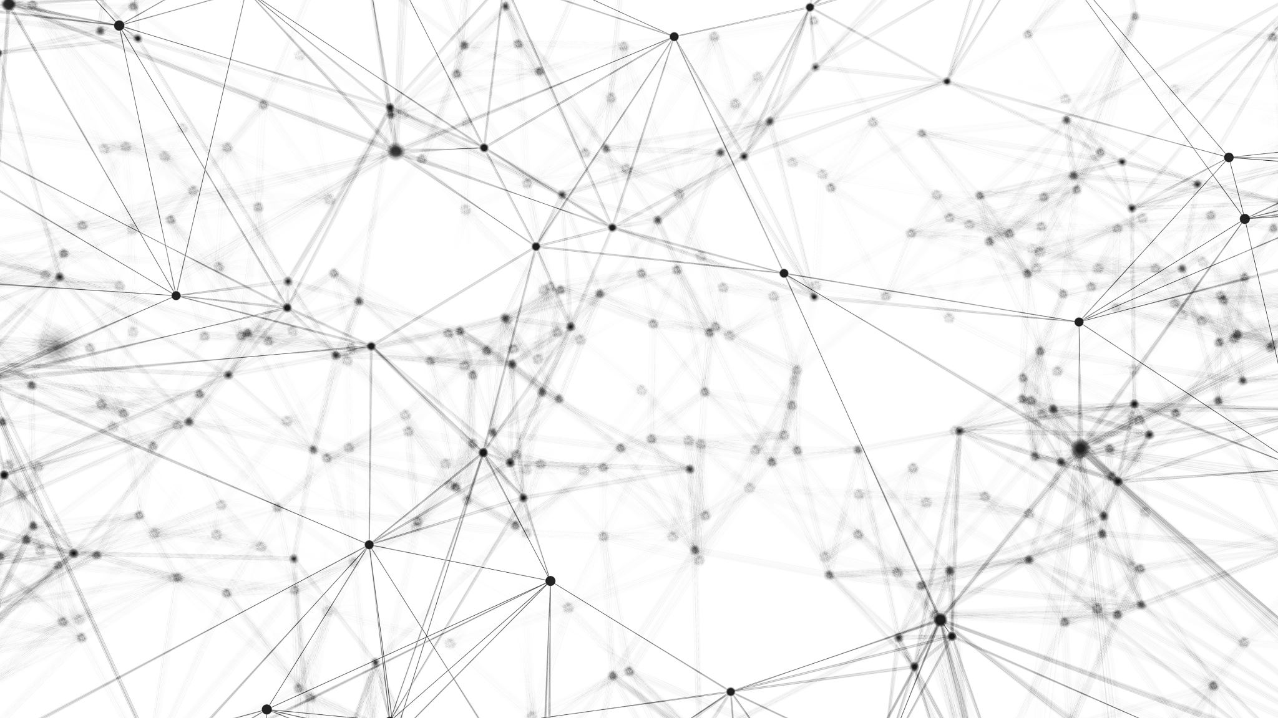
Introduction to AI, Spring 2023 Markov Decision Problems

Slide 2
Markov Decision Problems
This is the home stretch guys, and it’s a doozy.
It combines ‘grid world’ environments (from the very beginning of class!), with stochastic concepts (i.e., randomness/probability).
We’re ultimately doing all of this with the notion of figuring out rewards to dole out to agents, in the service of Reinforcement Learning, the third flavor of Machine Learning we promised we’d talk about
(after Supervised and Unsupervised)

Slide 3
Markov Decision Problems
But then it also is introducing a lot of new terms and concepts too!
As the title mentions, we’re talking about Markov Decision Problems.
Maybe you’ve heard/worked with “Markov Chains” or the “Markov Property” before.
When you hear Markovian you can think to yourself “Ah, we’re going to be dealing with state transitions that have probabilities attached to them…”
i.e., ”random” state transitions!

Slide 4
Markov Decision Problems
But before we get to the Markov-ey part of lecture…
We’re gonna begin in Deterministic Land.
i.e., deterministic == no uncertainty == *not* random
Markov == stochastic == probabilities == *yes* uncertainty == *yes* random.
Take a deep breath…

Slide 5



Grid World – Setting the Stage
Our triumphant return to Grid World.
The map has:
Walls that can’t be passed through
Fire
A Goal
And a robot – our agent.
Our Valiant robot can move N, S, E, W.

Slide 6
Grid World – Setting the Stage
Using the parlance of environments from so very long ago…
Observable:
Agents:
Deterministic?:
Episodic?:
Static?:
Discrete?:
Fully Observable
Single Agent
Deterministic
Sequential
Static
Discrete

Slide 7
Grid World – Setting the Stage
And we alluded to the idea of state transitions earlier on.
Here, the location of the robot is a state.
The robot changes its state by taking actions. Namely, moving N, S, E, or W.
North action
taken

Slide 8
Deterministic Process
A Deterministic Process describes how the world transitions from one state to another by taking actions. Ring a Bell?
L
A
B
L
A
B
R
S
R
S
S
S
A
B
A
B
R
A
B
A
B
L
L
L
R
L
R
R
S
S
A
B
A
B
R
L
L
R
S
S

Slide 9
Deterministic Process
A Deterministic Process can be thought of as a graph where the nodes are states and the edges are actions.
L
A
B
L
A
B
R
S
R
S
S
S
A
B
A
B
R
A
B
A
B
L
L
L
R
L
R
R
S
S
A
B
A
B
R
L
L
R
S
S

Slide 10
Deterministic Process
Crucially, with deterministic processes, there’s no uncertainty about the outcome of an action. You do the action, it takes you to the new state.
L
A
B
L
A
B
R
S
R
S
S
S
A
B
A
B
R
A
B
A
B
L
L
L
R
L
R
R
S
S
A
B
A
B
R
L
L
R
S
S

Slide 11
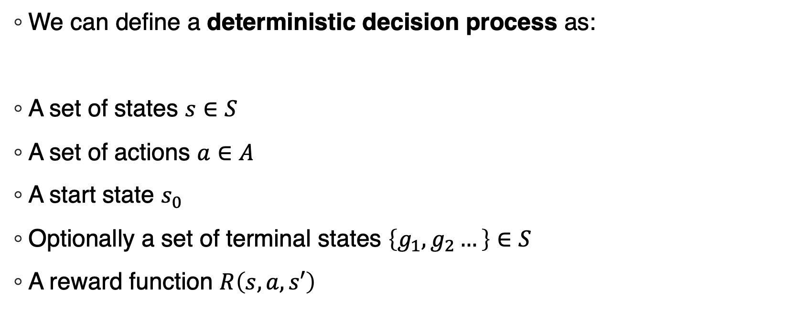
Deterministic Decision Process
We can define a deterministic decision process as:
A set of states $s∈S$
A set of actions $a∈A$
A start state $s_{0}$
Optionally a set of terminal states $\left\{g_{1},g_{2}…\right\}∈S$
A reward function $R\left(s,a,s′\right)$

Slide 12
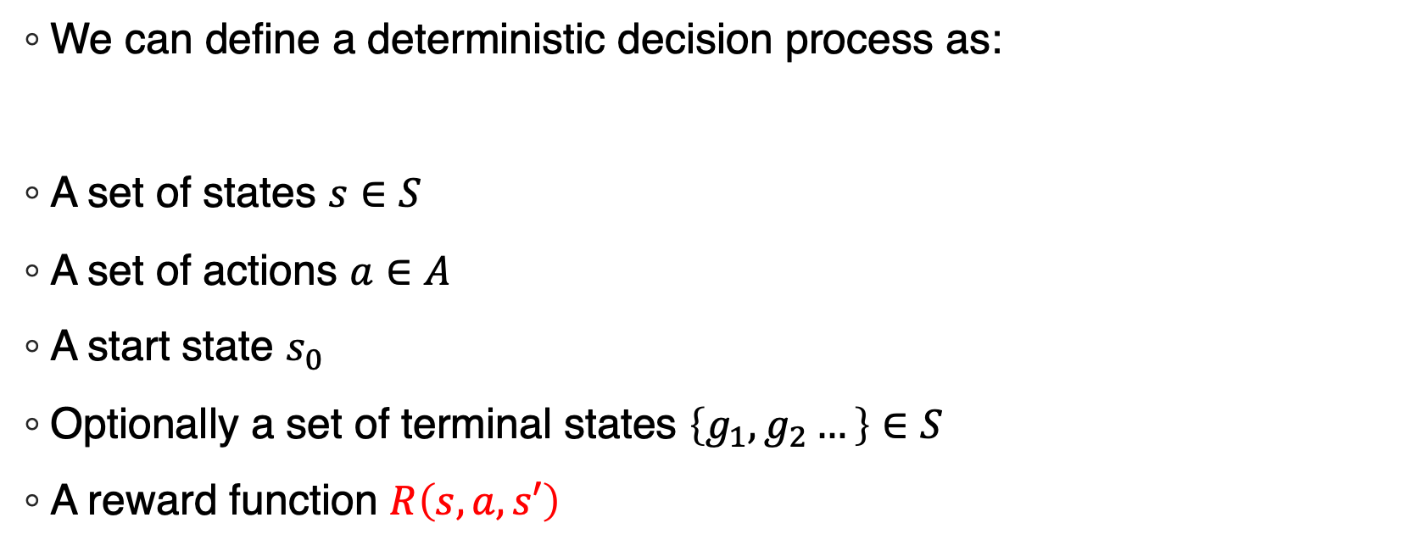
Deterministic Decision Process
We can define a deterministic decision process as:
A set of states $s∈S$
A set of actions $a∈A$
A start state $s_{0}$
Optionally a set of terminal states $\left\{g_{1},g_{2}…\right\}∈S$
A reward function $R\left(s,a,s′\right)$
Input to this function: You are currently in state s, and you take action a to reach a new state, s’
Output of this function: A number indicating how much do we like this new state?

Slide 13
Rewards
Throughout the course, we’ve often been very ‘goal oriented’ with these types of problems that involve choosing states.
“Reach a state where the enemy King is in checkmate!”
”Reach a state where there is no dirt on the ground!”
“Reach a state where all of the Cargo is in New Orleans!"

Slide 14
Rewards
Instead of goals, decision processes specify rewards.
Rewards can be positive (e.g., as you normally think of rewards).
Rewards can be negative (i.e., punishment).
A rational agent should try to maximize its rewards.

Slide 15
Rewards
A decision process can go on forever.
Some tasks, like “winning this chess game I’m currently playing” have a definite end point.
Other tasks, like “get better at playing the piano” do not. You can spend your whole life getting better.
The idea of a “goal” can be expressed as reaching a terminal state after maximizing your reward.

Slide 16
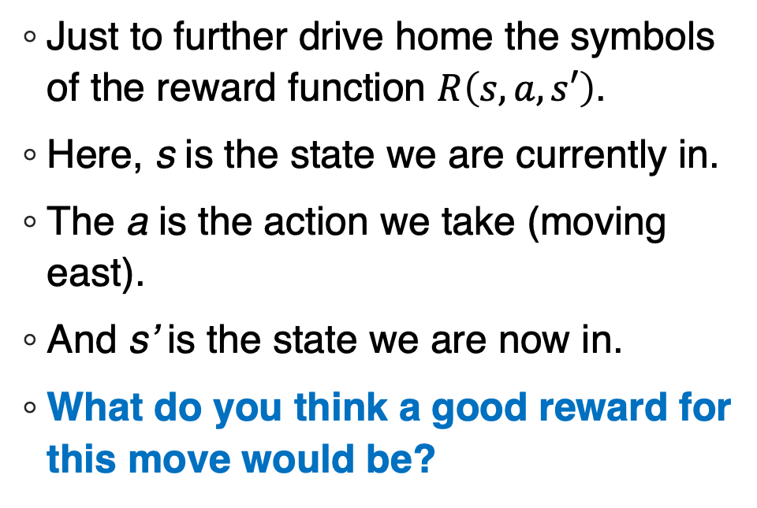
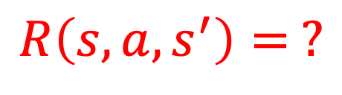
Rewards
Just to further drive home the symbols of the reward function $R\left(s,a,s′\right)$.
Here, s is the state we are currently in.
The a is the action we take (moving east).
And s’ is the state we are now in.
What do you think a good reward for this move would be?
s
East action
taken
a
s’
$$R\left(s,a,s^{′}\right)= ?$$

Slide 17
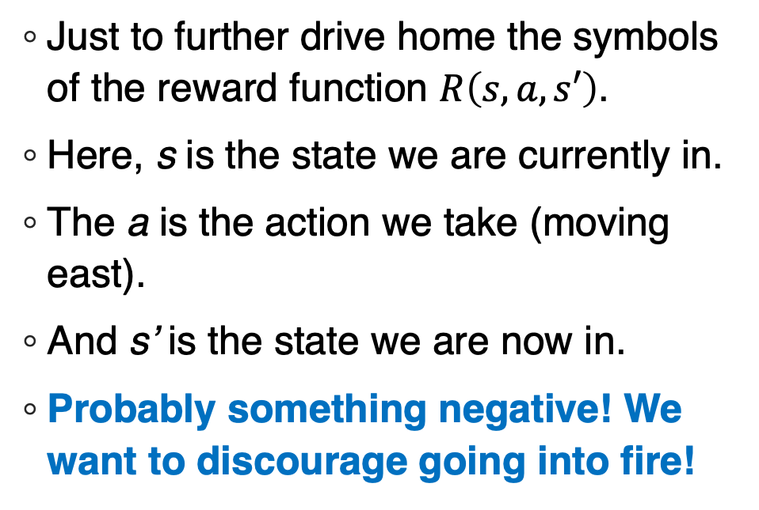
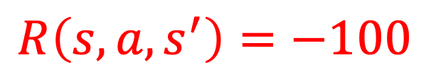
Rewards
Just to further drive home the symbols of the reward function $R\left(s,a,s′\right)$.
Here, s is the state we are currently in.
The a is the action we take (moving east).
And s’ is the state we are now in.
Probably something negative! We want to discourage going into fire!
s
East action
taken
a
s’
$$R\left(s,a,s^{′}\right)=−100$$

Slide 18
Designing Rewards
Remember when we first talked about rewards and utility scores in Vacuum world?
Why was it a bad idea to reward sucking up dirt?
(and instead, we changed it to rewarding clean spaces?)

Slide 19
Designing Rewards
Remember when we first talked about rewards and utility scores in Vacuum world?
Why was it a bad idea to reward sucking up dirt?
(and instead, we changed it to rewarding clean spaces?)
Because the robot might just keep on dumping the dirt out and sucking it back in again!
The takeaway was we reward states we like, not specific actions.

Slide 20
Designing Rewards
Rewards based on what we want:

Slide 21
Designing Rewards
+100
Rewards based on what we want:
Going to the flag is good, and is a terminal state.

Slide 22
Designing Rewards
+100
Rewards based on what we want:
Going to the flag is good, and is a terminal state.
Going to the fire is bad, and is a terminal state.
-100

Slide 23
Designing Rewards
-1
-1
-1
+100
Rewards based on what we want:
Going to the flag is good, and is a terminal state.
Going to the fire is bad, and is a terminal state.
Faster is better than slower.
Everything else is non-terminal, but a small punishment.
-1
-1
-100
-1
-1
-1
-1
With this, every time we move to a non-terminal state, our reward goes down a bit!
Gives us an incentive to not dawdle!

Slide 24
Policy
The solution to a decision process is called a policy.
It is typically denoted with the pi symbol, π
A policy tells us what to do for any given state we might find ourselves in.

Slide 25
Policy
Exit
The solution to a decision process is called a policy.
It is typically denoted with the pi symbol, π
A policy tells us what to do in every state we might be in.
For a deterministic decision process, a policy is simply a plan.
i.e., a set of steps that take us from a start state to an end state.
i.e., what we were talking about before we transitioned to ML.
In this example, “North, North, East, East, East” would be a good plan/policy that would take us from the start to a happy end.

Slide 26
Policy
Exit
BUT WHAT IF IT ISN’T DETERMINISTIC???
What if you took an action…
And you weren’t entirely sure what would happen as a result?

Slide 27
Policy
Like… for example…
What if we were in this situation again…
And we take the NORTH action (as opposed to the East action like before)…
But we STILL end up moving east into the fire anyway?
s
*NORTH* action
taken
a
s’

Slide 28
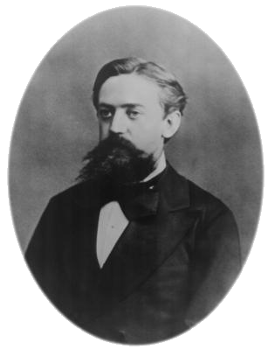
Markov
Enter Dr. Markov!
Andrey Markov was a famous mathematician who studied stochastic processes.
i.e., probability and random variables!
Let’s chat about his eponymous Markov Property.

Slide 29
Markov Process
Now that we are living in stochastic world, we don’t know with one hundred percent confidence what state we end up in after we take an action.
BUT, we will assume these transitions have the Markov property (or are Markovian).
OK, great! But what IS the Markov property…?
East action
taken
?

Slide 30
Markov Process
The Markov property states that *what came before* doesn’t matter for the current transition.
The only thing that matters is *where we are now* i.e., the current state, and the action we take in it.
East action
taken
?

Slide 31
Markov Process
The Markov property states that *what came before* doesn’t matter for the current transition. The only thing that matters is *where we are now* i.e., the current state, and the action we take in it.
In other words, it doesn’t matter if we got to our current state with a sequence actions that follow this green path…
East action
taken
?

Slide 32
Markov Process
The Markov property states that *what came before* doesn’t matter for the current transition. The only thing that matters is *where we are now* i.e., the current state and the action we take in it.
Or we followed this red path…
East action
taken
?

Slide 33
Markov Process
The Markov property states that *what came before* doesn’t matter for the current transition. The only thing that matters is *where we are now* i.e., the current state and the action we take in it.
In other words, it doesn’t matter if we got to the spot following the green path… or the red path…
We are now in state s. And that’s what matters.
East action
taken
?

Slide 34
Markov Process
Or, using the symbols from earlier in the semester…
P(s’ | s, a)
“The probability of ending up in state s’ only depends on the current state s and the action a taken within it”
History makes no impact! Past states and past actions do not affect the probability of the new state we’ll end up when taking an action in the current state!
East action
taken
?

Slide 35
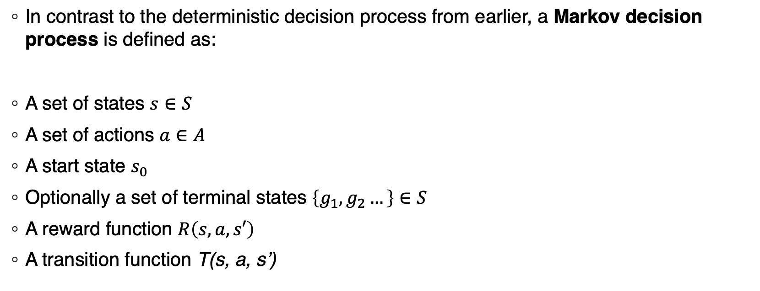
Markov Decision Process
In contrast to the deterministic decision process from earlier, a Markov decision process is defined as:
A set of states $s∈S$
A set of actions $a∈A$
A start state $s_{0}$
Optionally a set of terminal states $\left\{g_{1},g_{2}…\right\}∈S$
A reward function $R\left(s,a,s′\right)$
A transition function T(s, a, s’)

Slide 36
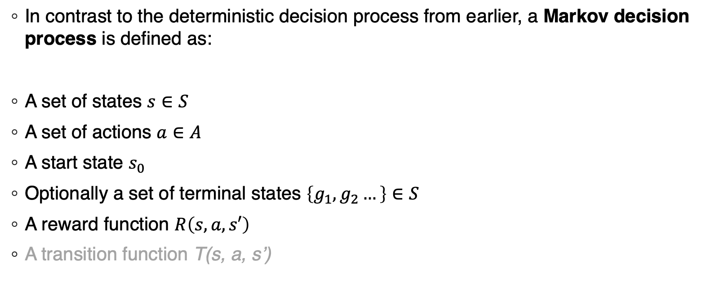
Markov Decision Process
In contrast to the deterministic decision process from earlier, a Markov decision process is defined as:
A set of states $s∈S$
A set of actions $a∈A$
A start state $s_{0}$
Optionally a set of terminal states $\left\{g_{1},g_{2}…\right\}∈S$
A reward function $R\left(s,a,s′\right)$
A transition function T(s, a, s’)
These are the same as in the deterministic process.

Slide 37
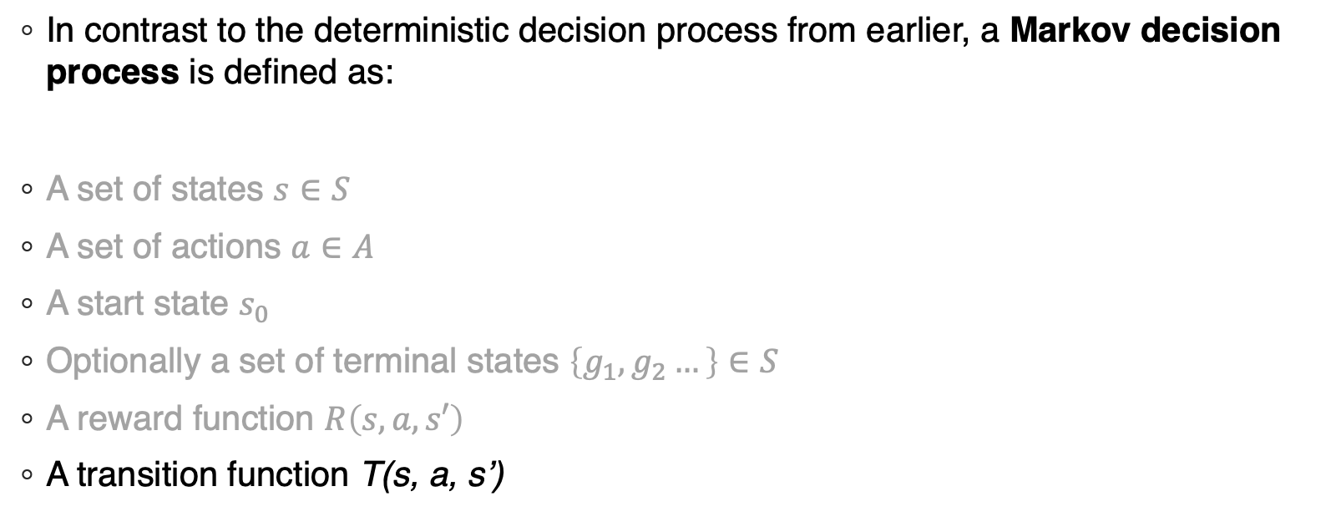
Markov Decision Process
In contrast to the deterministic decision process from earlier, a Markov decision process is defined as:
A set of states $s∈S$
A set of actions $a∈A$
A start state $s_{0}$
Optionally a set of terminal states $\left\{g_{1},g_{2}…\right\}∈S$
A reward function $R\left(s,a,s′\right)$
A transition function T(s, a, s’)
This is the new part! And it’s what we just talked about!

Slide 38
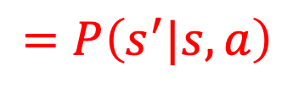
Markov Decision Process
In contrast to the deterministic decision process from earlier, a Markov decision process is defined as:
A set of states $s∈S$
A set of actions $a∈A$
A start state $s_{0}$
Optionally a set of terminal states $\left\{g_{1},g_{2}…\right\}∈S$
A reward function $R\left(s,a,s′\right)$
A transition function T(s, a, s’)
What is the probability that if you
are in state s…
$$=P\left(s^{′}|s,a\right)$$

Slide 39
Markov Decision Process
In contrast to the deterministic decision process from earlier, a Markov decision process is defined as:
A set of states $s∈S$
A set of actions $a∈A$
A start state $s_{0}$
Optionally a set of terminal states $\left\{g_{1},g_{2}…\right\}∈S$
A reward function $R\left(s,a,s′\right)$
A transition function T(s, a, s’)
What is the probability that if you
are in state s… and you take action a…
$$=P\left(s^{′}|s,a\right)$$

Slide 40
Markov Decision Process
In contrast to the deterministic decision process from earlier, a Markov decision process is defined as:
A set of states $s∈S$
A set of actions $a∈A$
A start state $s_{0}$
Optionally a set of terminal states $\left\{g_{1},g_{2}…\right\}∈S$
A reward function $R\left(s,a,s′\right)$
A transition function T(s, a, s’)
What is the probability that if you
are in state s… and you take action a…
you end up in state s’ ?
$$=P\left(s^{′}|s,a\right)$$

Slide 41
Grid World Revisited
The map has walls, fires, and a goal.
Our Valiant robot can move N, S, E, W.

Slide 42
Stochastic Grid World
The map has walls, fires, and a goal.
Our Valiant Malfunctioning robot can try to move N, S, E, W.

Slide 43
Stochastic Grid World
The map has walls, fires, and a goal.
Our Valiant Malfunctioning robot can try to move N, S, E, W.
When moving, there is a 10% chance that the robot veers to the side *instead* of the requested direction.
So when taking the N action...
P(n) = 80%
P(w) = 10%
P(e) = 10%
P(s) = 0%
Going West…
P(n) = 10%
P(w) = 80%
P(e) = 0%
P(s) = 10%
Going East…
P(n) = 10%
P(w) = 0%
P(e) = 80%
P(s) = 10%
Going South…
P(n) = 0%
P(w) = 10%
P(e) = 10%
P(s) = 80%

Slide 44
Stochastic Grid World
Going South…
P(n) = 0%
P(w) = 10%
P(e) = 10%
P(s) = 80%
Do the “Move South” action…
Veered east, ran into fire, very bad, ouch.
Veered west, bumped into wall, so didn’t move
T: 10%
T: 10%
R: -1
R: -1
R: -100
T: 80%

Slide 45
Stochastic Grid World Policy
Exit
As we discussed just a moment ago for deterministic processes…
The solution to a decision process is called a policy.
It is typically denoted with the pi symbol, π
A policy tells us what to do in every state we might be in.
For a Markov decision process, our policy still tells us the best thing to do in any given state…
But it depends on the probabilities of taking any given action, and the rewards of any given state.

Slide 46
Stochastic Grid World Policy
Rewards
Policy
-1
-1
-1
+100
exit
-1
-1
-100
exit
-1
-1
-1
-1
Let’s examine how changing the reward scores affects our policies. Here, in the case where all non-terminal states are -1…

Slide 47
Stochastic Grid World Policy
If in this square, always take the ‘east’ action
Rewards
Policy
-1
-1
-1
+100
exit
-1
-1
-100
exit
-1
-1
-1
-1
I claim that these arrows represent the ‘optimal’ policy.
(You can read this policy map as the arrow telling you which action you should take if you ever find yourself in that square).
If in this square, always take the ‘west’ action

Slide 48
Stochastic Grid World Policy
Rewards
Policy
-1
-1
-1
+100
exit
-1
-1
-100
exit
-1
-1
-1
-1
One interesting thing to note here: we have the luxury of avoiding the fire at all costs.

Slide 49
Stochastic Grid World Policy
We really avoid the fire!
Rewards
Policy
-1
-1
-1
+100
exit
-1
-1
-100
exit
-1
-1
-1
-1
In any state that we *might* end in the fire, keep taking the action that ensures we don’t hit the fire.
80% of the time we bump into a wall, but the penalty of being in these -1 squares is so low that it’s worth it to avoid the -100 square.
And *eventually* you’ll veer to a different square, enabling you to continue again.

Slide 50
Stochastic Grid World Policy
Rewards
Policy
-3
-3
-3
+100
exit
-3
-3
-100
exit
-3
-3
-3
-3
What if we increased the penalty for dawdling? Let’s change the -1s to -3?

Slide 51
Stochastic Grid World Policy
Willing to risk a 10% chance of fire.
Rewards
Policy
-3
-3
-3
+100
exit
-3
-3
-100
exit
-3
-3
-3
-3
But also willing to take the long way around to avoid danger.
Mostly the same, but willing to take a small risk.
-3 is *just bad enough* that it isn’t worth bumping into a wall again and again.
But *not so bad* that we’re still willing to take a longer walk to avoid all fire potential.

Slide 52
Stochastic Grid World Policy
Rewards
Policy
-4
-4
-4
+100
exit
-4
-4
-100
exit
-4
-4
-4
-4
What if we tweaked it to -4?

Slide 53
Stochastic Grid World Policy
Take the shortest path to the good exit!
Rewards
Policy
-4
-4
-4
+100
exit
-4
-4
-100
exit
-4
-4
-4
-4
Now we’re not willing to take the longer round-about-but-fire-free-way.
Take the shortest path to the flag as possible, even if sometimes you accidentally stray into fire.

Slide 54
Stochastic Grid World Policy
Rewards
Policy
-200
-200
-200
+100
exit
-200
-200
-100
exit
-200
-200
-200
-200
What if we changed non-fire squares to -200?

Slide 55
Stochastic Grid World Policy
Throw yourself into the flames. Just get out!
Rewards
Policy
-200
-200
-200
+100
exit
-200
-200
-100
exit
-200
-200
-200
-200
Life is so miserable for the robot, that the fire is preferable to any non-terminal state.
Just get to *any* exit, as quickly as possible.

Slide 56
Reward: How Much and When?
Which is better?
Time 1: $1 Time 1: $2
Time 2: $2 or Time 2: $3
Time 3: $3 Time 3: $4

Slide 57
Reward: How Much and When?
Which is better?
Time 1: $1 Time 1: $2
Time 2: $2 or Time 2: $3
Time 3: $3 Time 3: $4
More is better than less!

Slide 58
Reward: How Much and When?
Which is better?
Time 1: $1 Time 1: $2
Time 2: $2 or Time 2: $3
Time 3: $3 Time 3: $4
Which is better?
Time 1: $0 Time 1: $3
Time 2: $0 or Time 2: $0
Time 3: $3 Time 3: $0
More is better than less!

Slide 59
Reward: How Much and When?
Which is better?
Time 1: $1 Time 1: $2
Time 2: $2 or Time 2: $3
Time 3: $3 Time 3: $4
Which is better?
Time 1: $0 Time 1: $3
Time 2: $0 or Time 2: $0
Time 3: $3 Time 3: $0
More is better than less!
Sooner is better than later!

Slide 60
How to Measure Rewards
Rewards
Policy
-1
-1
-1
+100
exit
-1
-1
-100
exit
-1
-1
-1
-1
Let’s say these are the rewards on the left, and the right represents the policy.
Never-minding about the stochasticity for a second, what do we think our ultimate reward is going to be here if the robot starts in the lower left?

Slide 61
How to Measure Rewards: Additive
Rewards
Policy
-1
-1
-1
+100
exit
-1
-1
-100
exit
-1
-1
-1
-1
One way to measure it is to simply add up all of the rewards on the path you think you are going to take.
Here, that would be -1 + -1+ -1+ -1 + -1 + 100 = 95.
But that isn’t taking into account “sooner is better than later”

Slide 62
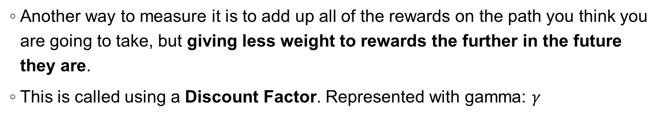
How to Measure Rewards: Discounted
Rewards
Policy
-1
-1
-1
+100
exit
-1
-1
-100
exit
-1
-1
-1
-1
Another way to measure it is to add up all of the rewards on the path you think you are going to take, but giving less weight to rewards the further in the future they are.
This is called using a Discount Factor. Represented with gamma: $γ$
Notes:
-.5
-.25
-.125
-.0625
3.125
-----
-1 + -0.95 + -0.9975 + -0.99999375 +

Slide 63
Solving a Markov Decision Process (MDP)
Because this is a stochastic problem, there is no way to guarantee that we’ll get the maximum reward.
But, we can still aim for a policy that is most likely to get the maximum reward.
We want to maximize the expected reward.
You can think of expected reward as your “likely final score”
Because of randomness, you aren’t guaranteed to get that exact score…
But if you kept choosing those same moves again and again, on average you’d expect to get it!

Slide 64
Solving a Markov Decision Process (MDP)
Expected reward is, in the book, referred to as Utility.
You can now think of each state as having *two* numbers in it now:
The red number is the same as it’s been, the reward for being in that state.
The blue number is the expected reward or utility. That is “if I find myself in this state and act optimally, what do I think my *final* reward is going to be”
Finding a policy, then, is choosing actions to lead you to states that maximize this utility score!
-1
51.91

Slide 65
Solving a Markov Decision Process (MDP)
If things were deterministic, it would be as easy to compute these utilities!
You look at the reward of any given state, add ‘em up (maybe with a discount factor), and call it a day!
But remember: things aren’t deterministic here!
We are about to introduce / derive a cool equation, the Bellman Equation, to help us figure out the expected reward of a state living in non-deterministic land.
Before we do, imagine we have the following at our disposal…

Slide 66
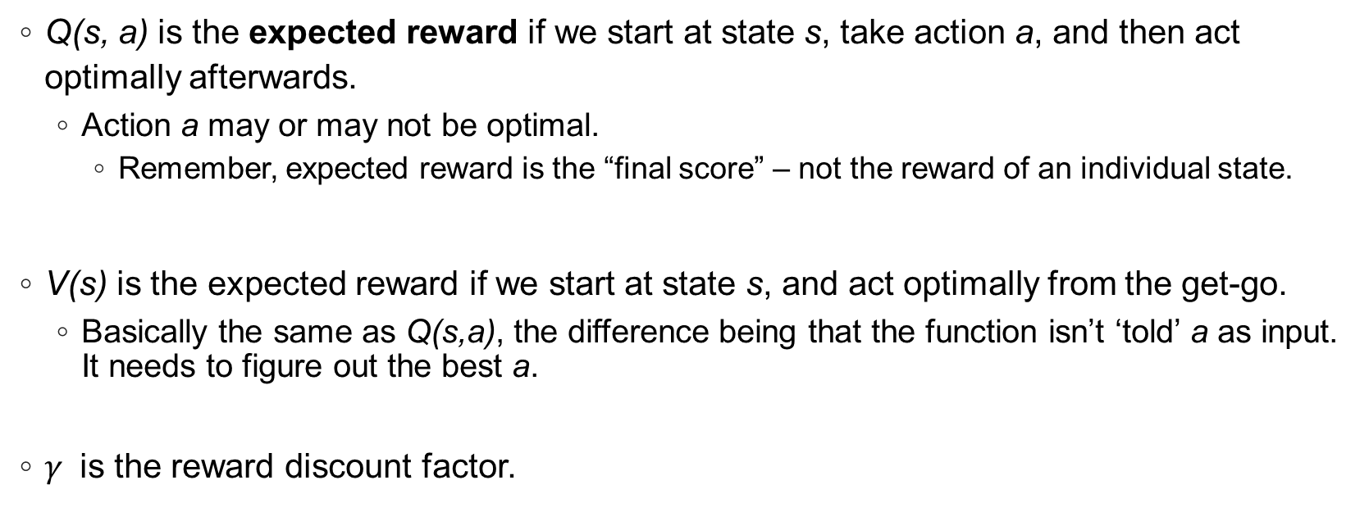
Solving a Markov Decision Process (MDP)
Q(s, a) is the expected reward if we start at state s, take action a, and then act optimally afterwards.
Action a may or may not be optimal.
Remember, expected reward is the “final score” – not the reward of an individual state.
V(s) is the expected reward if we start at state s, and act optimally from the get-go.
Basically the same as Q(s,a), the difference being that the function isn’t ‘told’ a as input. It needs to figure out the best a.
$γ$ is the reward discount factor.

Slide 67
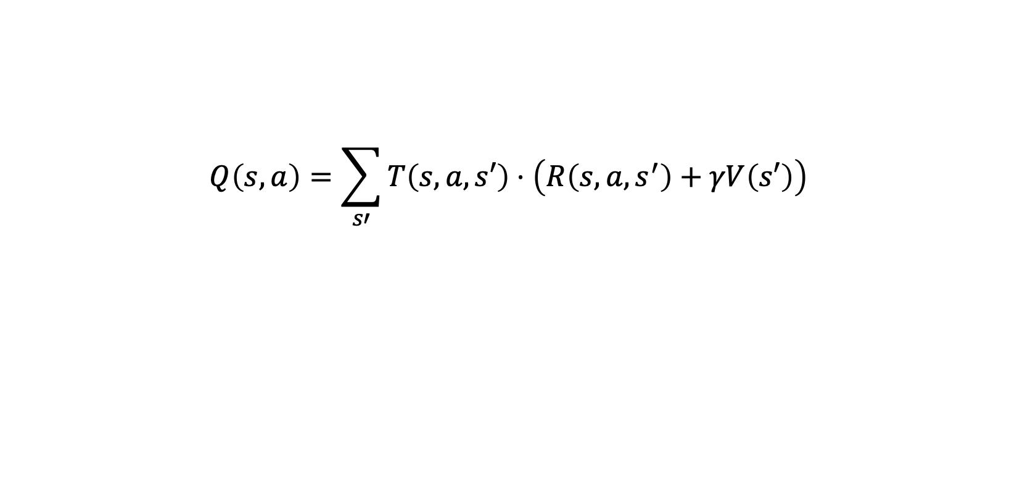
Deriving the Bellman Equation
$$Q\left(s,a\right)=\sum_{s′}{T\left(s,a,s′\right)⋅\left(R\left(s,a,s^{′}\right)+γV\left(s′\right)\right)}$$

Slide 68
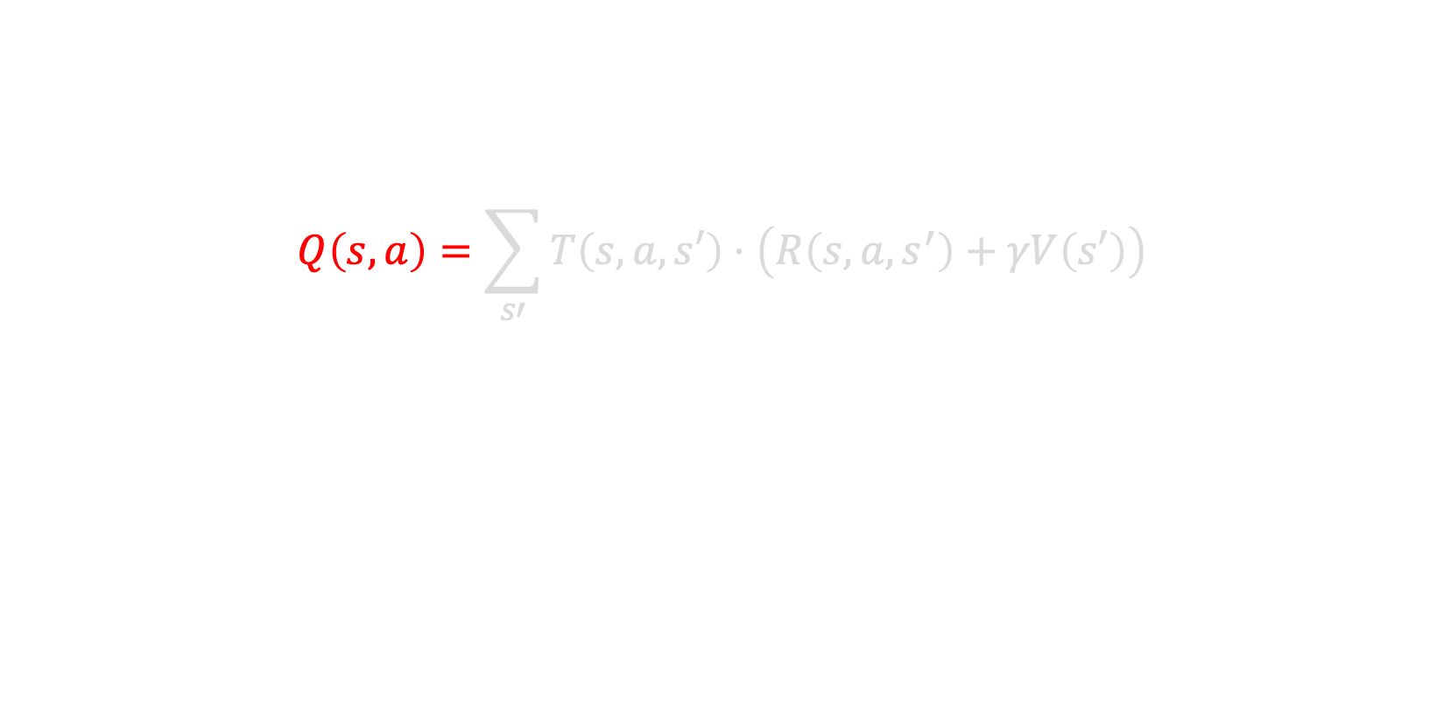
Deriving the Bellman Equation
$$Q\left(s,a\right)=\sum_{s′}{T\left(s,a,s′\right)⋅\left(R\left(s,a,s^{′}\right)+γV\left(s′\right)\right)}$$
The expected reward of taking action a in state s is…

Slide 69
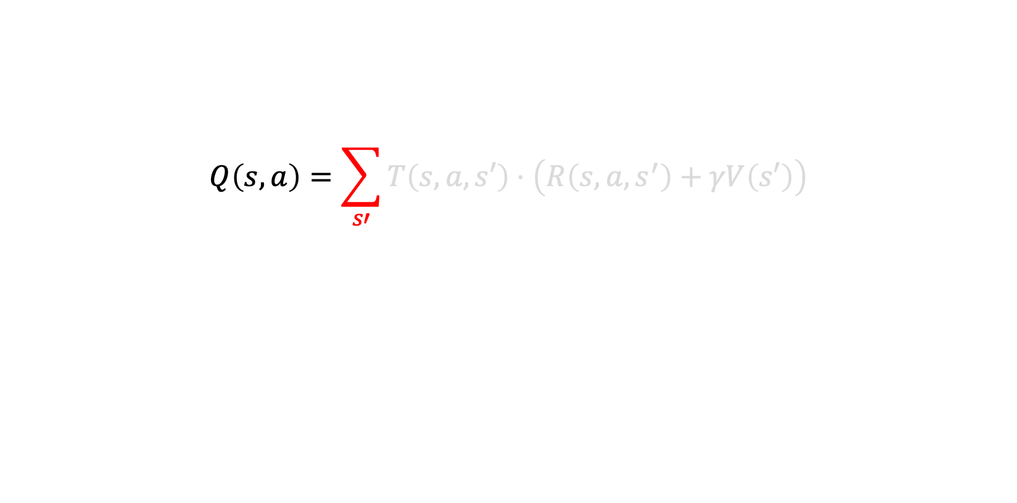
Deriving the Bellman Equation
$$Q\left(s,a\right)=\sum_{s′}{T\left(s,a,s′\right)⋅\left(R\left(s,a,s^{′}\right)+γV\left(s′\right)\right)}$$
For all possible states s’ that you might end up in after taking action a in state s…

Slide 70
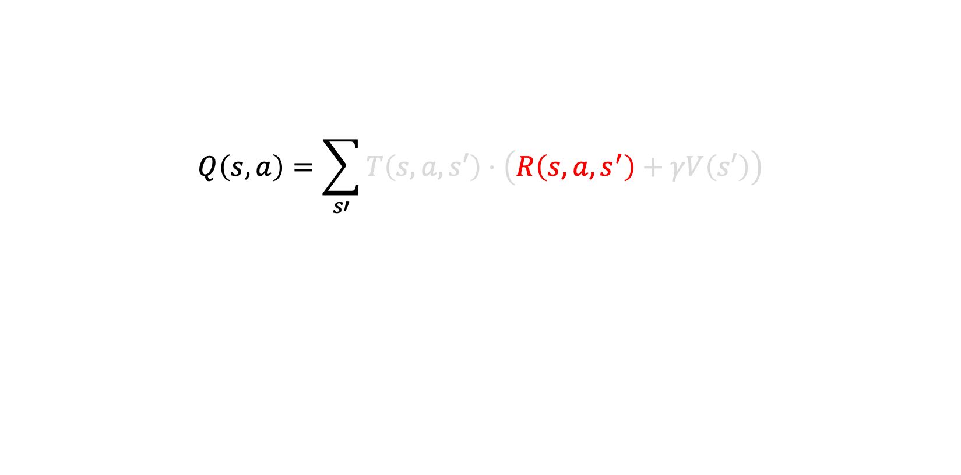
Deriving the Bellman Equation
$$Q\left(s,a\right)=\sum_{s′}{T\left(s,a,s′\right)⋅\left(R\left(s,a,s^{′}\right)+γV\left(s′\right)\right)}$$
The reward for ending up in that state…

Slide 71
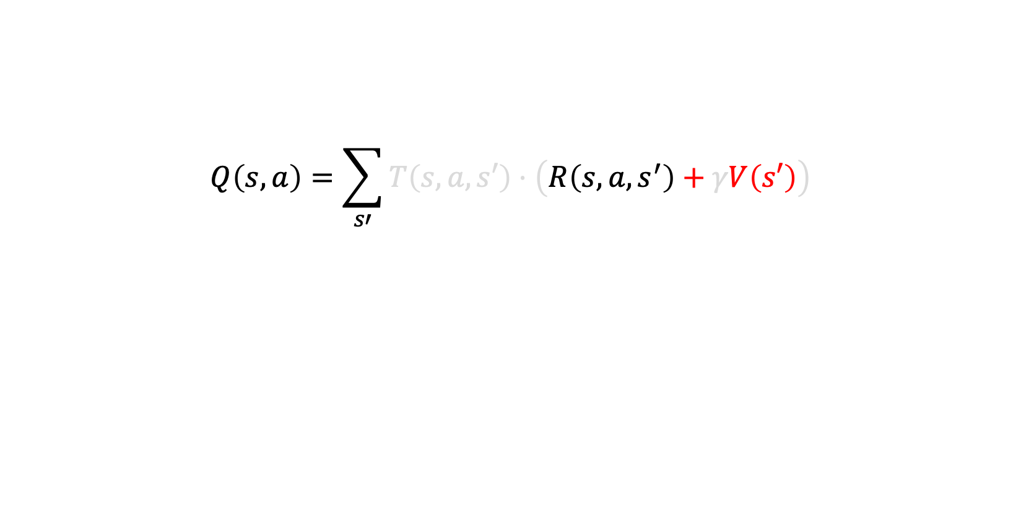
Deriving the Bellman Equation
$$Q\left(s,a\right)=\sum_{s′}{T\left(s,a,s′\right)⋅\left(R\left(s,a,s^{′}\right)+γV\left(s′\right)\right)}$$
…Plus the expected reward for acting optimally afterwards…

Slide 72
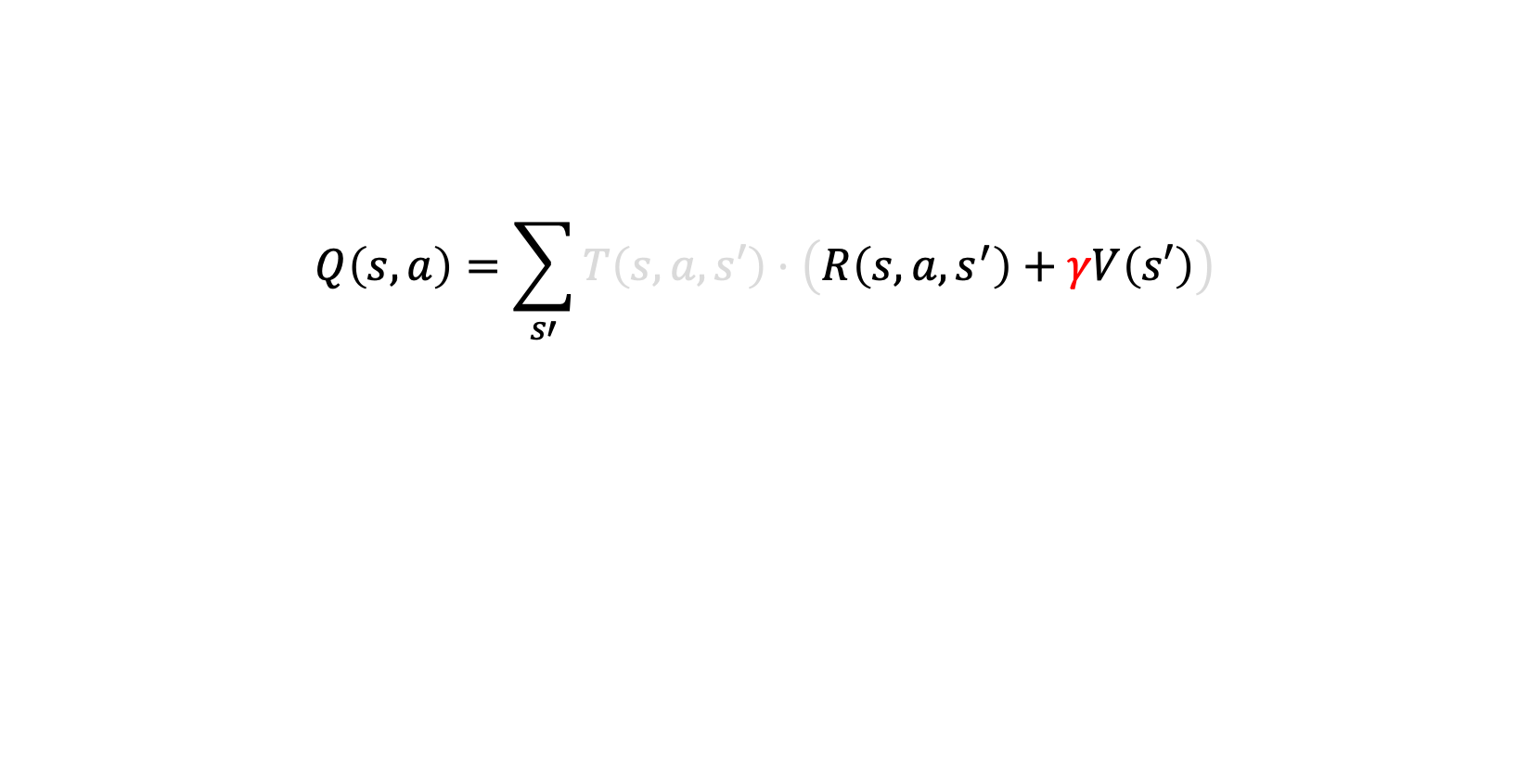
Deriving the Bellman Equation
$$Q\left(s,a\right)=\sum_{s′}{T\left(s,a,s′\right)⋅\left(R\left(s,a,s^{′}\right)+γV\left(s′\right)\right)}$$
…Discounted by the the discount factor, because sooner is better than later…

Slide 73
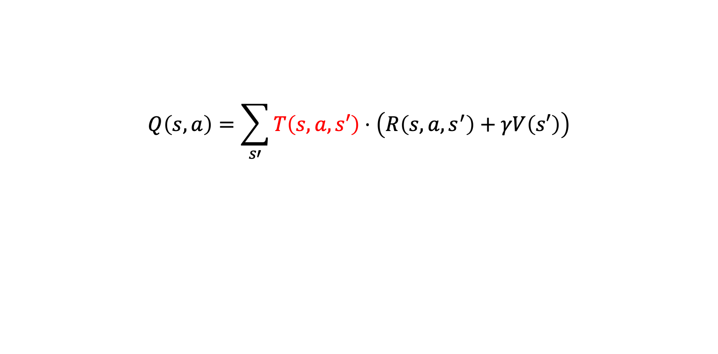
Deriving the Bellman Equation
$$Q\left(s,a\right)=\sum_{s′}{T\left(s,a,s′\right)⋅\left(R\left(s,a,s^{′}\right)+γV\left(s′\right)\right)}$$
…Weighted by the likelihood that you actually end up in state s’ when you take action a from state s.

Slide 74
Deriving the Bellman Equation
$$Q\left(s,a\right)=\sum_{s′}{T\left(s,a,s′\right)⋅\left(R\left(s,a,s^{′}\right)+γV\left(s′\right)\right)}$$
This is the expected reward for a state, s, when we take a specific action inside of it.
But generally speaking, we are only interested in *one* action: the BEST action.
That’s what the next equation gets at!

Slide 75
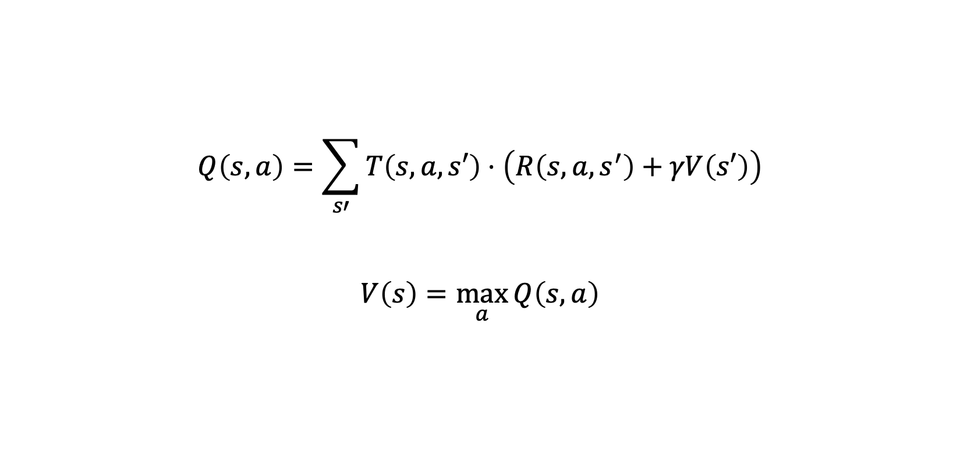
Deriving the Bellman Equation
$$Q\left(s,a\right)=\sum_{s′}{T\left(s,a,s′\right)⋅\left(R\left(s,a,s^{′}\right)+γV\left(s′\right)\right)}$$
$$V\left(s\right)=\max_{a}{Q\left(s,a\right)}$$

Slide 76
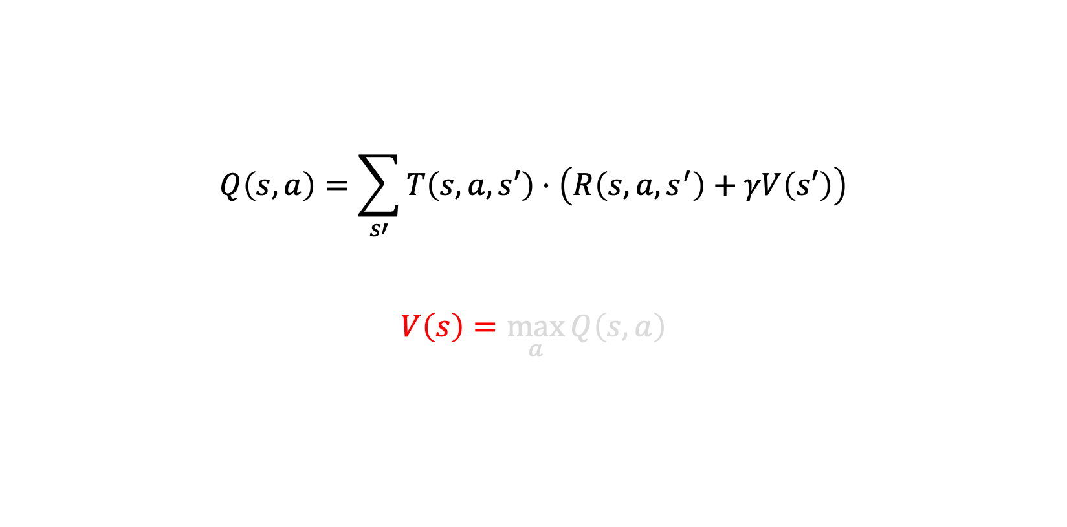
Deriving the Bellman Equation
$$Q\left(s,a\right)=\sum_{s′}{T\left(s,a,s′\right)⋅\left(R\left(s,a,s^{′}\right)+γV\left(s′\right)\right)}$$
$$V\left(s\right)=\max_{a}{Q\left(s,a\right)}$$
The reward you should expect to get if you find yourself in state s is…

Slide 77
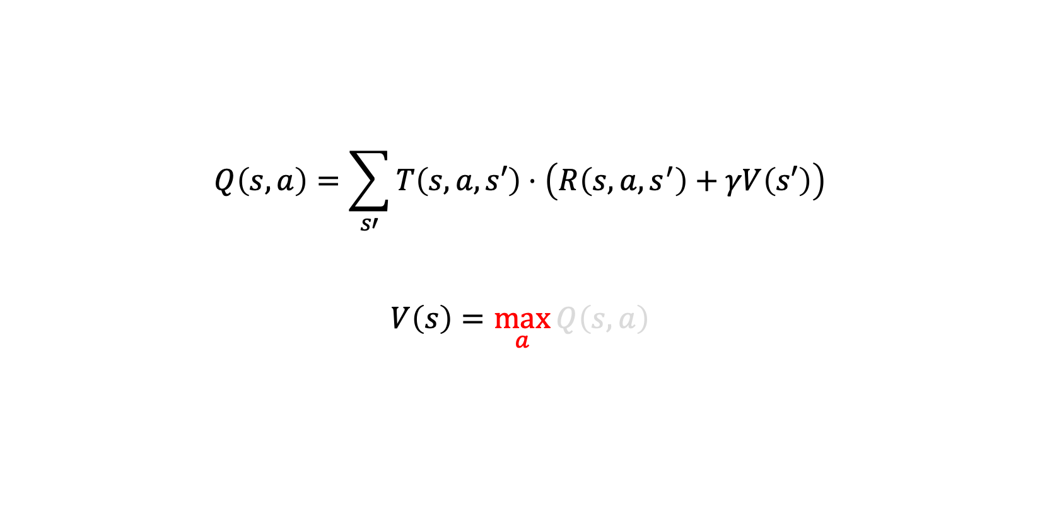
Deriving the Bellman Equation
$$Q\left(s,a\right)=\sum_{s′}{T\left(s,a,s′\right)⋅\left(R\left(s,a,s^{′}\right)+γV\left(s′\right)\right)}$$
$$V\left(s\right)=\max_{a}{Q\left(s,a\right)}$$
… of all the possible actions a we can take in state s…

Slide 78
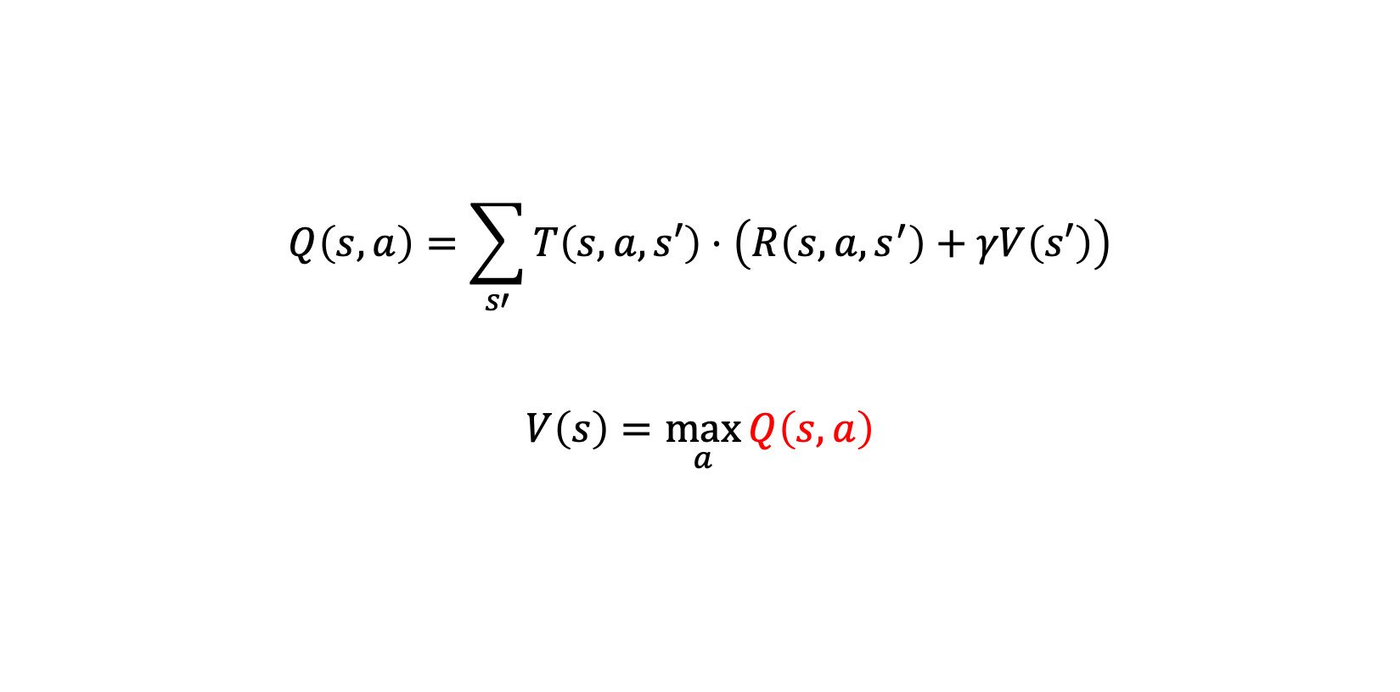
Deriving the Bellman Equation
$$Q\left(s,a\right)=\sum_{s′}{T\left(s,a,s′\right)⋅\left(R\left(s,a,s^{′}\right)+γV\left(s′\right)\right)}$$
$$V\left(s\right)=\max_{a}{Q\left(s,a\right)}$$
… choose the action that maximizes the expected reward. i.e., the best action.

Slide 79
Deriving the Bellman Equation
$$Q\left(s,a\right)=\sum_{s′}{T\left(s,a,s′\right)⋅\left(R\left(s,a,s^{′}\right)+γV\left(s′\right)\right)}$$
$$V\left(s\right)=\max_{a}{Q\left(s,a\right)}$$
Or in other words, loop through all the actions, keep track of the expected reward of each, and return the highest expected reward you find.

Slide 80
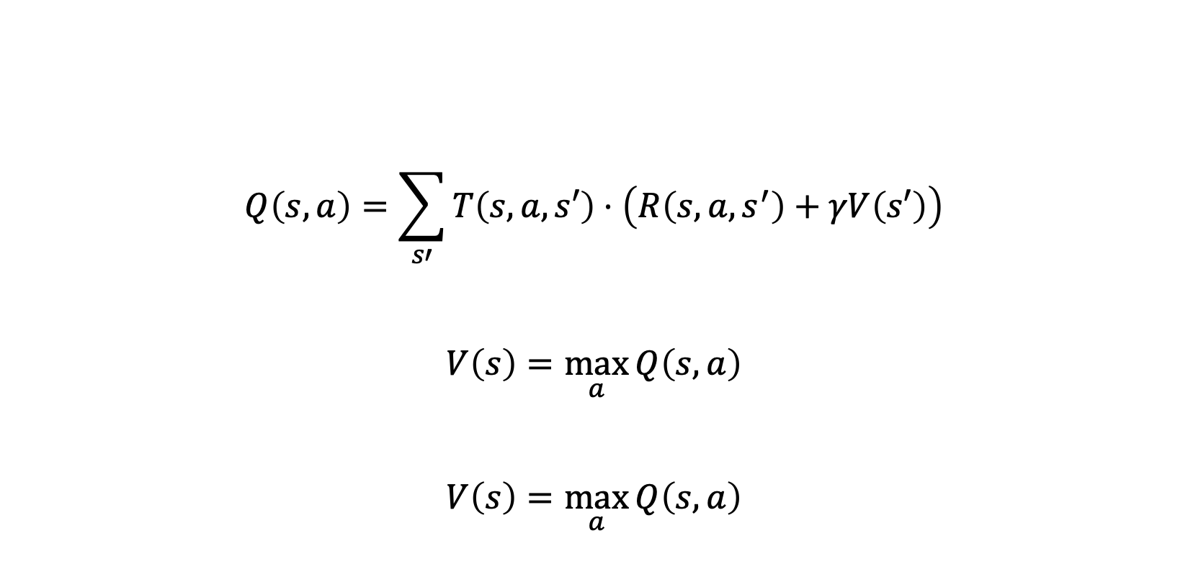
Deriving the Bellman Equation
$$Q\left(s,a\right)=\sum_{s′}{T\left(s,a,s′\right)⋅\left(R\left(s,a,s^{′}\right)+γV\left(s′\right)\right)}$$
$$V\left(s\right)=\max_{a}{Q\left(s,a\right)}$$
$$V\left(s\right)=\max_{a}{Q\left(s,a\right)}$$
Here I’ve just written that second equation down a second time. We’ll see why in a moment…

Slide 81
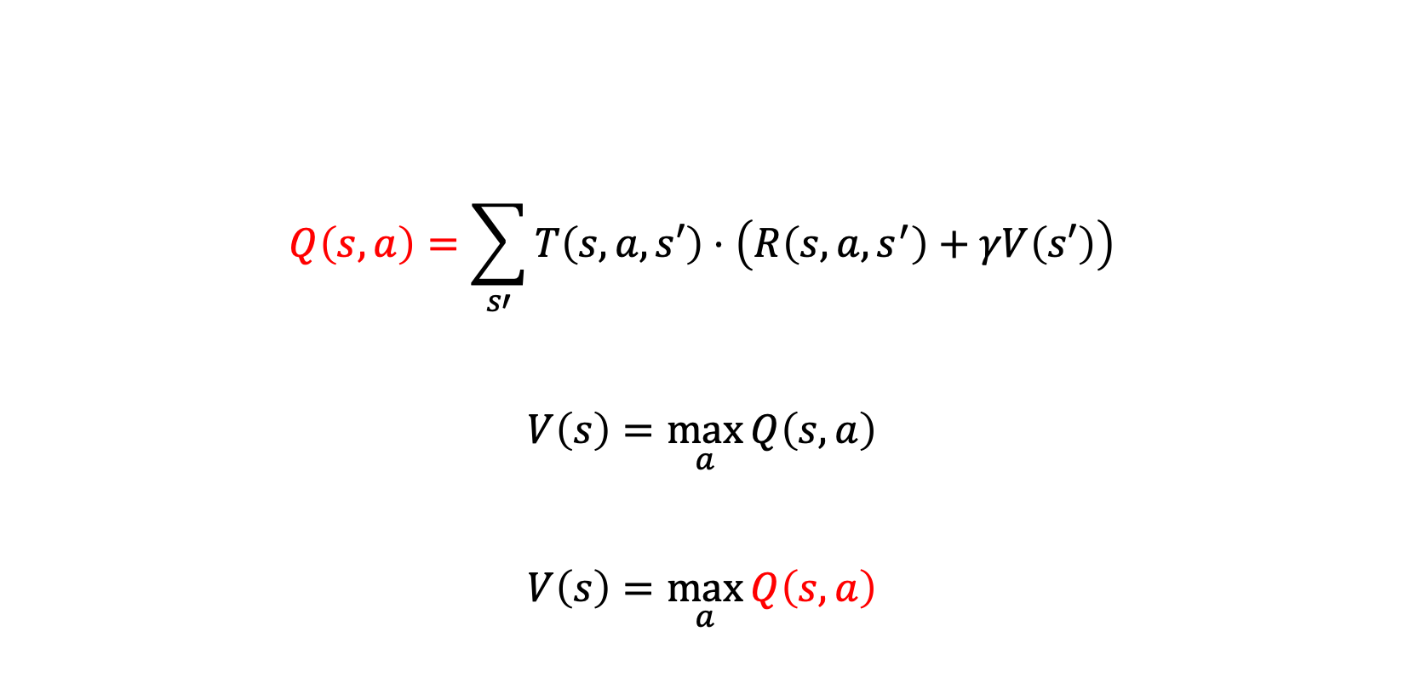
Deriving the Bellman Equation
$$Q\left(s,a\right)=\sum_{s′}{T\left(s,a,s′\right)⋅\left(R\left(s,a,s^{′}\right)+γV\left(s′\right)\right)}$$
$$V\left(s\right)=\max_{a}{Q\left(s,a\right)}$$
$$V\left(s\right)=\max_{a}{Q\left(s,a\right)}$$
Here we have two references for Q(s,a)… we do some substitution…

Slide 82
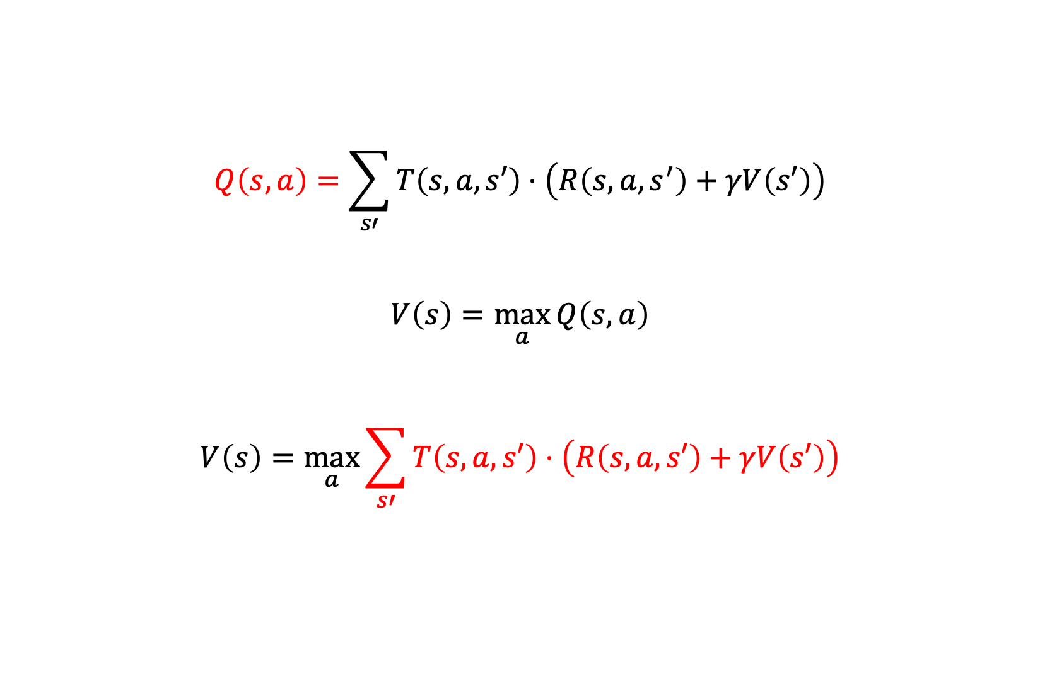
Deriving the Bellman Equation
$$Q\left(s,a\right)=\sum_{s′}{T\left(s,a,s′\right)⋅\left(R\left(s,a,s^{′}\right)+γV\left(s′\right)\right)}$$
$$V\left(s\right)=\max_{a}{Q\left(s,a\right)}$$
$$V\left(s\right)=\max_{a}{\sum_{s′}{T\left(s,a,s′\right)⋅\left(R\left(s,a,s′\right)+γV\left(s′\right)\right)}}$$
We get this!

Slide 83
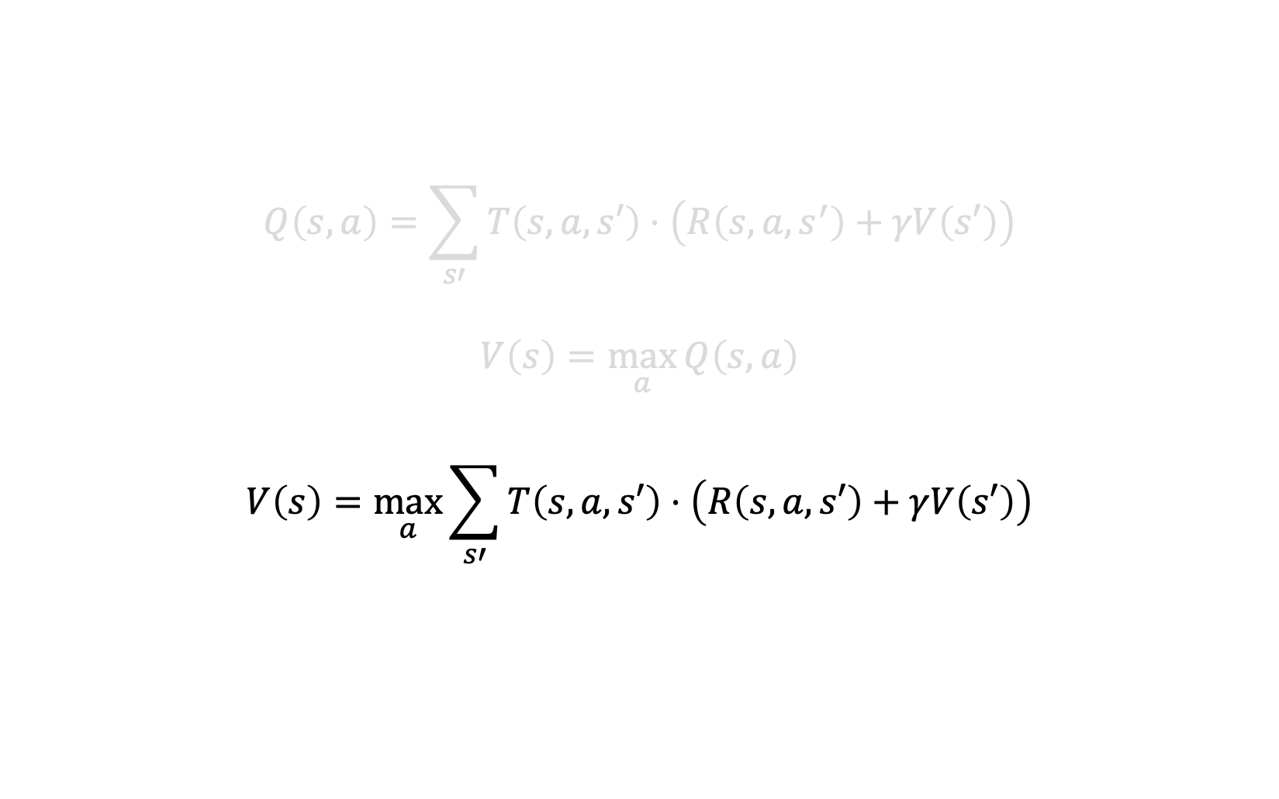
The Bellman Equation
$$Q\left(s,a\right)=\sum_{s′}{T\left(s,a,s′\right)⋅\left(R\left(s,a,s^{′}\right)+γV\left(s′\right)\right)}$$
$$V\left(s\right)=\max_{a}{Q\left(s,a\right)}$$
$$V\left(s\right)=\max_{a}{\sum_{s′}{T\left(s,a,s′\right)⋅\left(R\left(s,a,s′\right)+γV\left(s′\right)\right)}}$$
This is the Bellman Equation. You can use it to compute the expected reward from some given state, s.

Slide 84
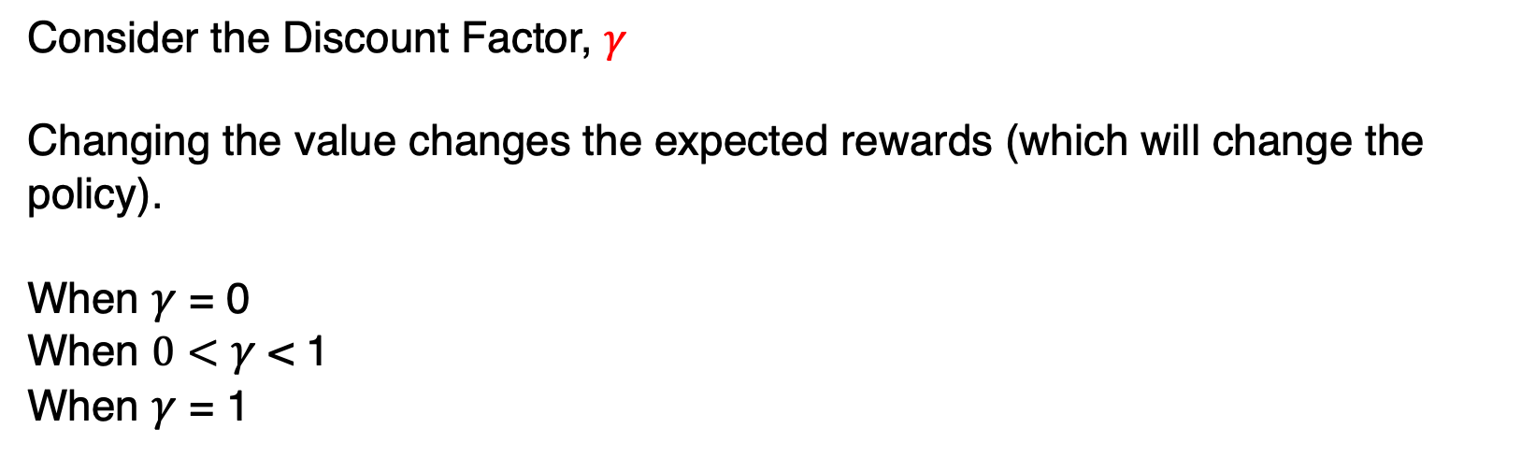
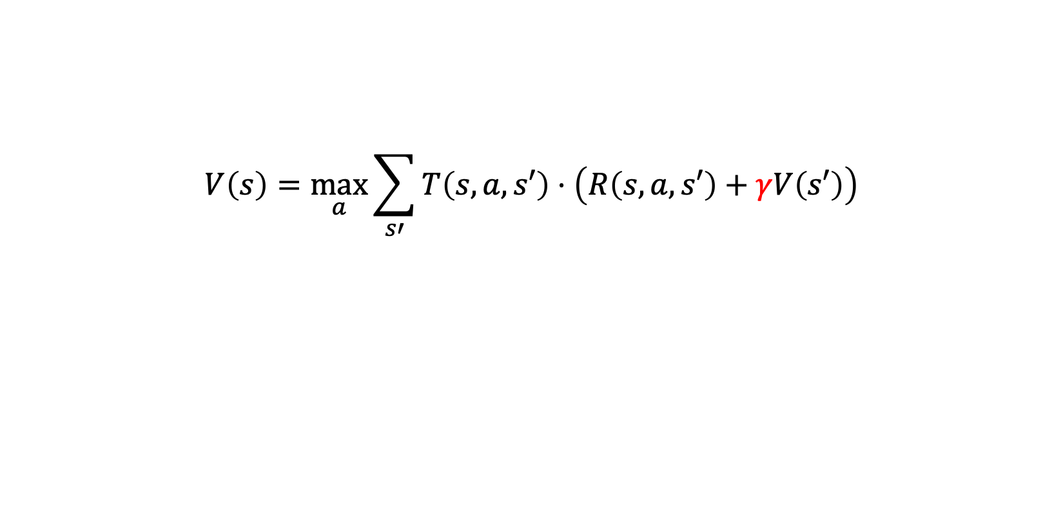
The Bellman Equation: Discount Factor
$$V\left(s\right)=\max_{a}{\sum_{s′}{T\left(s,a,s′\right)⋅\left(R\left(s,a,s′\right)+γV\left(s′\right)\right)}}$$
Consider the Discount Factor, $γ$
Changing the value changes the expected rewards (which will change the policy).
When $γ$ = 0
When $0<γ$ < 1
When $γ$ = 1
Future rewards have no value.
Future rewards have ‘less’ value (sooner is better than later).
Future rewards have ‘normal’ value (sooner is as good as later)

Slide 85
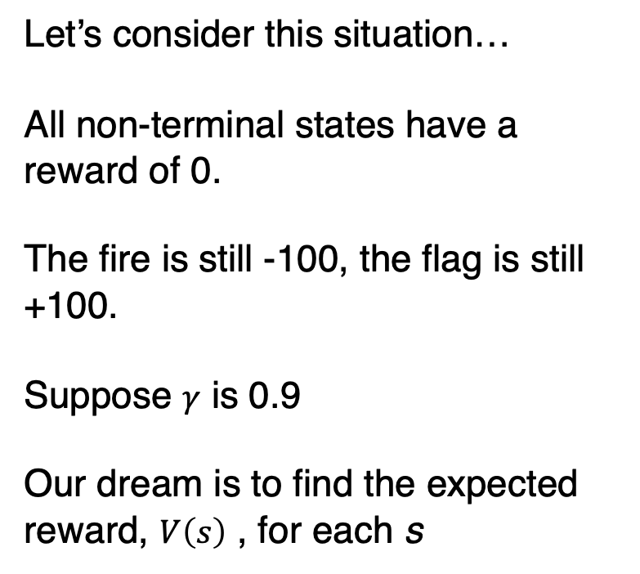
Stochastic Grid World Policy
+0
?
+0
?
+0
?
+100
Let’s consider this situation…
All non-terminal states have a reward of 0.
The fire is still -100, the flag is still +100.
Suppose $γ$ is 0.9
Our dream is to find the expected reward, $V\left(s\right)$ , for each s
+0
?
+0
?
-100
+0
?
+0
?
+0
?
+0
?

Slide 86
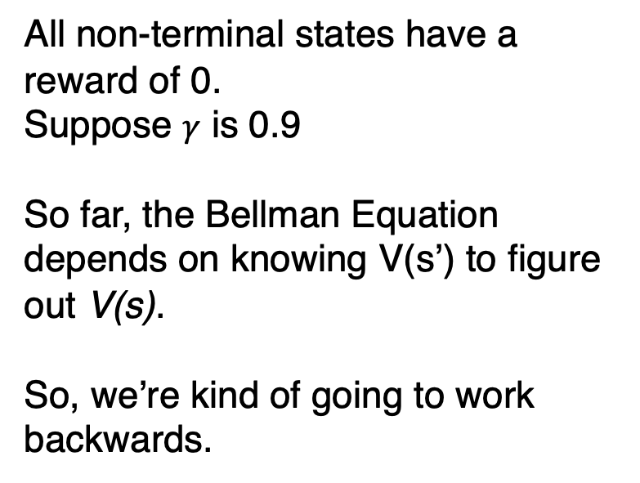
Stochastic Grid World Policy
?
?
?
+100
All non-terminal states have a reward of 0.
Suppose $γ$ is 0.9
So far, the Bellman Equation depends on knowing V(s’) to figure out V(s).
So, we’re kind of going to work backwards.
?
?
-100
?
?
?
?

Slide 87
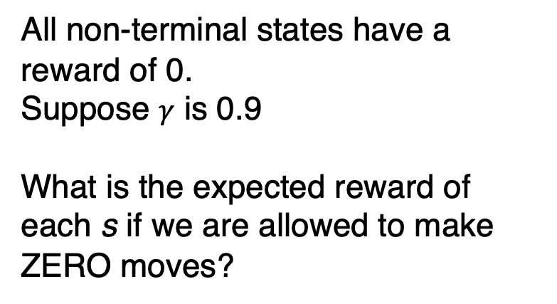
Stochastic Grid World Policy
?
?
?
+100
All non-terminal states have a reward of 0.
Suppose $γ$ is 0.9
What is the expected reward of each s if we are allowed to make ZERO moves?
?
?
-100
?
?
?
?

Slide 88
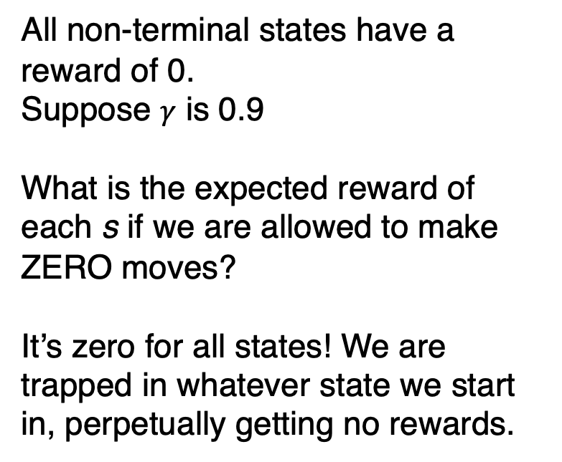
Stochastic Grid World Policy
0
0
0
+100
All non-terminal states have a reward of 0.
Suppose $γ$ is 0.9
What is the expected reward of each s if we are allowed to make ZERO moves?
It’s zero for all states! We are trapped in whatever state we start in, perpetually getting no rewards.
0
0
-100
0
0
0
0

Slide 89
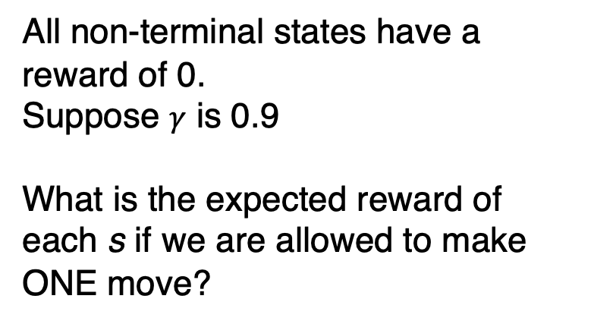
Stochastic Grid World Policy
?
?
?
+100
All non-terminal states have a reward of 0.
Suppose $γ$ is 0.9
What is the expected reward of each s if we are allowed to make ONE move?
?
?
-100
?
?
?
?

Slide 90
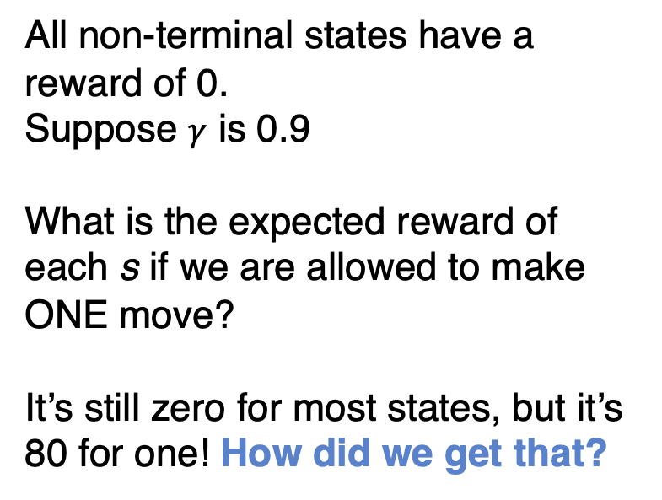
Stochastic Grid World Policy
0
0
80
+100
All non-terminal states have a reward of 0.
Suppose $γ$ is 0.9
What is the expected reward of each s if we are allowed to make ONE move?
It’s still zero for most states, but it’s 80 for one! How did we get that?
0
0
-100
0
0
0
0

Slide 91
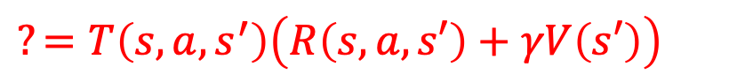
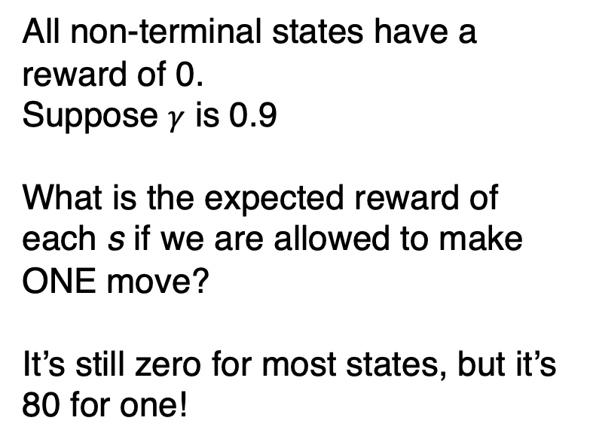
Stochastic Grid World Policy
0
0
80
+100
All non-terminal states have a reward of 0.
Suppose $γ$ is 0.9
What is the expected reward of each s if we are allowed to make ONE move?
It’s still zero for most states, but it’s 80 for one!
0
0
-100
0
0
0
0
Best outcome is moving east, but only an 80% chance it will work
$$?=T\left(s,a,s^{′}\right)\left(R\left(s,a,s′\right)+γV\left(s′\right)\right)$$

Slide 92

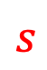
Stochastic Grid World Policy
0
0
$$s$$
+100
All non-terminal states have a reward of 0.
Suppose $γ$ is 0.9
What is the expected reward of each s if we are allowed to make ONE move?
It’s still zero for most states, but it’s 80 for one!
80
$$s′$$
0
0
-100
0
0
0
0
$$?=T\left(s,east,s^{′}\right)\left(R\left(s,east,s′\right)+γV\left(s′\right)\right)$$

Slide 93
Stochastic Grid World Policy
0
0
$$s$$
+100
All non-terminal states have a reward of 0.
Suppose $γ$ is 0.9
What is the expected reward of each s if we are allowed to make ONE move?
It’s still zero for most states, but it’s 80 for one!
80
$$s′$$
0
0
-100
0
0
0
0
$$?=.80∗\left(R\left(s,east,s′\right)+γV\left(s′\right)\right)$$

Slide 94
Stochastic Grid World Policy
0
0
$$s$$
+100
All non-terminal states have a reward of 0.
Suppose $γ$ is 0.9
What is the expected reward of each s if we are allowed to make ONE move?
It’s still zero for most states, but it’s 80 for one!
80
$$s′$$
0
0
-100
0
0
0
0
$$?=.80∗\left(100+γV\left(s′\right)\right)$$

Slide 95
Stochastic Grid World Policy
0
0
$$s$$
+100
All non-terminal states have a reward of 0.
Suppose $γ$ is 0.9
What is the expected reward of each s if we are allowed to make ONE move?
It’s still zero for most states, but it’s 80 for one!
80
$$s′$$
0
0
-100
0
0
0
0
$$?=.80∗\left(100+0\right)$$

Slide 96
Stochastic Grid World Policy
0
0
$$s$$
+100
All non-terminal states have a reward of 0.
Suppose $γ$ is 0.9
What is the expected reward of each s if we are allowed to make ONE move?
It’s still zero for most states, but it’s 80 for one!
80
$$s′$$
0
0
-100
0
0
0
0
$$80=.80∗\left(100+0\right)$$

Slide 97
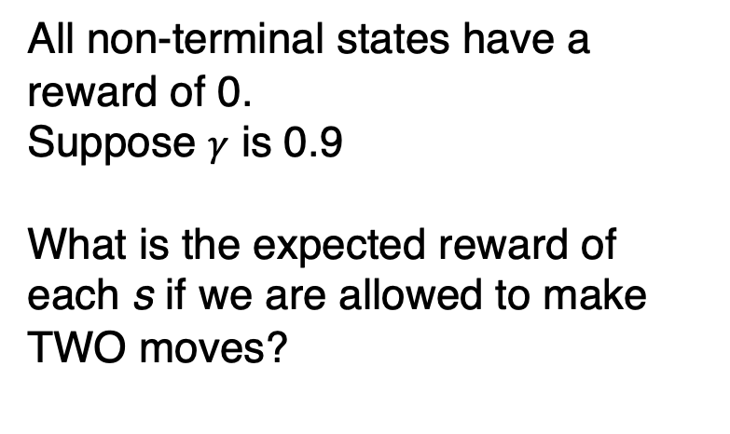
Stochastic Grid World Policy
?
?
80
+100
All non-terminal states have a reward of 0.
Suppose $γ$ is 0.9
What is the expected reward of each s if we are allowed to make TWO moves?
?
?
-100
?
?
?
?

Slide 98
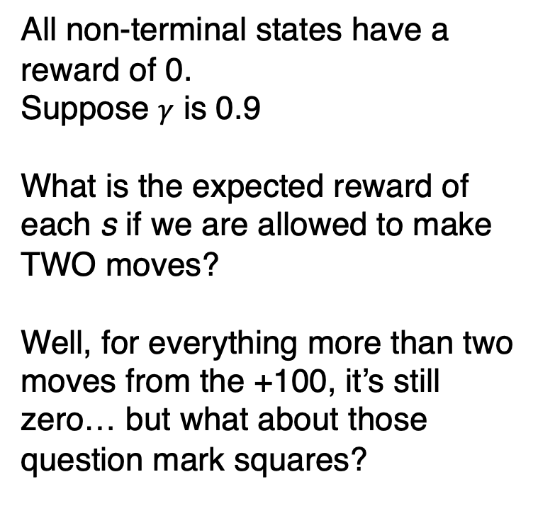
Stochastic Grid World Policy
0
?
80
+100
All non-terminal states have a reward of 0.
Suppose $γ$ is 0.9
What is the expected reward of each s if we are allowed to make TWO moves?
Well, for everything more than two moves from the +100, it’s still zero… but what about those question mark squares?
0
?
-100
0
0
0
0

Slide 99
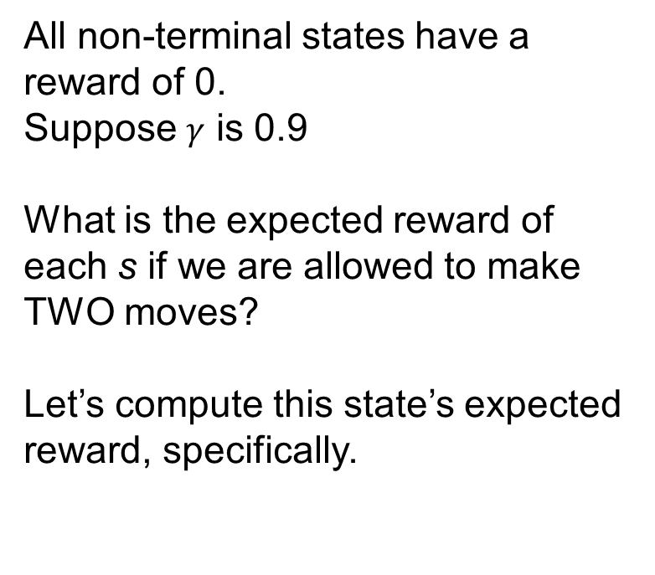
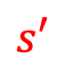
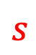
Stochastic Grid World Policy
0
?
80
+100
All non-terminal states have a reward of 0.
Suppose $γ$ is 0.9
What is the expected reward of each s if we are allowed to make TWO moves?
Let’s compute this state’s expected reward, specifically.
$$s$$
$$s′$$
0
?
-100
0
0
0
0
$$?=T\left(s,a,s^{′}\right)\left(R\left(s,a,s′\right)+γV\left(s′\right)\right)$$

Slide 100
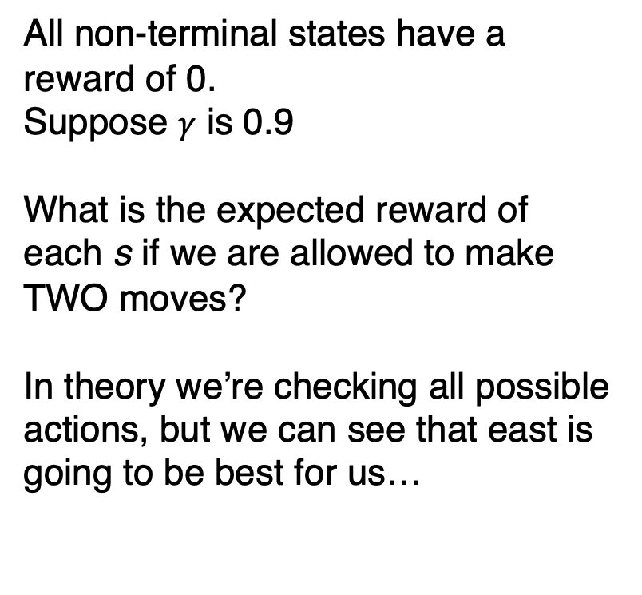
Stochastic Grid World Policy
0
?
80
+100
All non-terminal states have a reward of 0.
Suppose $γ$ is 0.9
What is the expected reward of each s if we are allowed to make TWO moves?
In theory we’re checking all possible actions, but we can see that east is going to be best for us…
$$s$$
$$s′$$
0
?
-100
0
0
0
0
$$?=T\left(s,east,s^{′}\right)\left(R\left(s,east,s′\right)+γV\left(s′\right)\right)$$

Slide 101
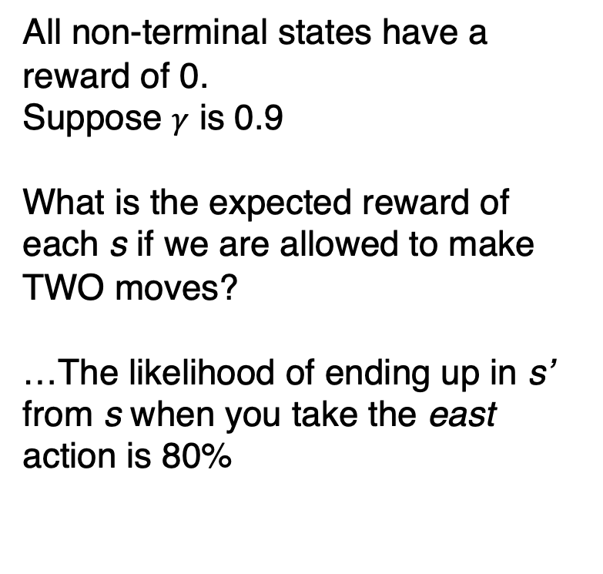
Stochastic Grid World Policy
0
?
80
+100
All non-terminal states have a reward of 0.
Suppose $γ$ is 0.9
What is the expected reward of each s if we are allowed to make TWO moves?
…The likelihood of ending up in s’ from s when you take the east action is 80%
$$s$$
$$s′$$
0
?
-100
0
0
0
0
$$?=0.80\left(R\left(s,east,s′\right)+γV\left(s′\right)\right)$$

Slide 102
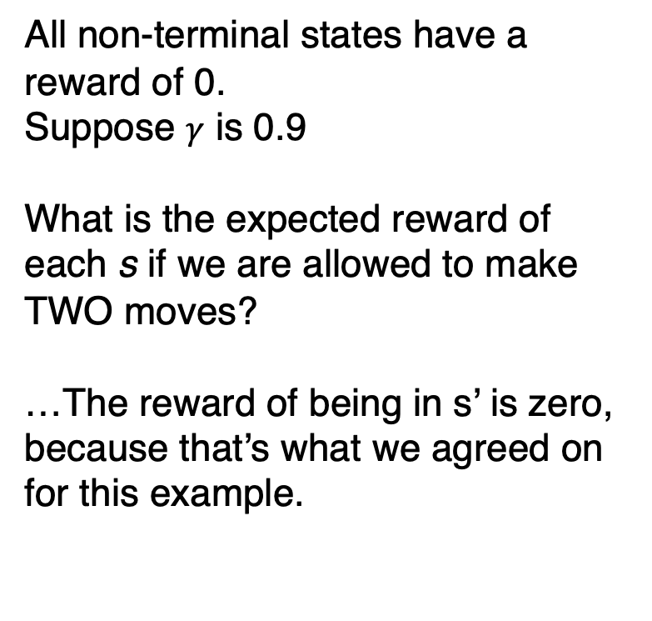
Stochastic Grid World Policy
0
?
80
+100
All non-terminal states have a reward of 0.
Suppose $γ$ is 0.9
What is the expected reward of each s if we are allowed to make TWO moves?
…The reward of being in s’ is zero, because that’s what we agreed on for this example.
$$s$$
$$s′$$
0
?
-100
0
0
0
0
$$?=0.80\left(0+γV\left(s′\right)\right)$$

Slide 103
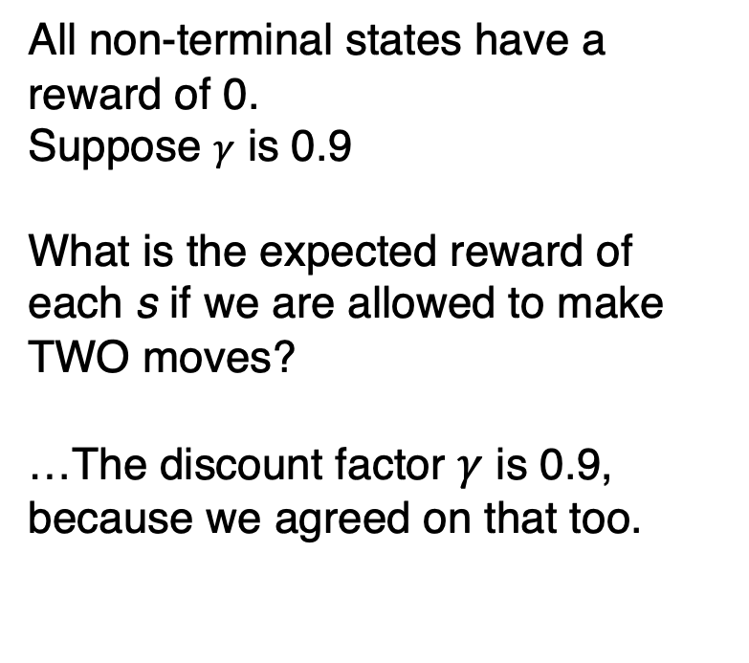
Stochastic Grid World Policy
0
?
80
+100
All non-terminal states have a reward of 0.
Suppose $γ$ is 0.9
What is the expected reward of each s if we are allowed to make TWO moves?
…The discount factor $γ$ is 0.9, because we agreed on that too.
$$s$$
$$s′$$
0
?
-100
0
0
0
0
$$?=0.80\left(0+0.9∗V\left(s′\right)\right)$$

Slide 104
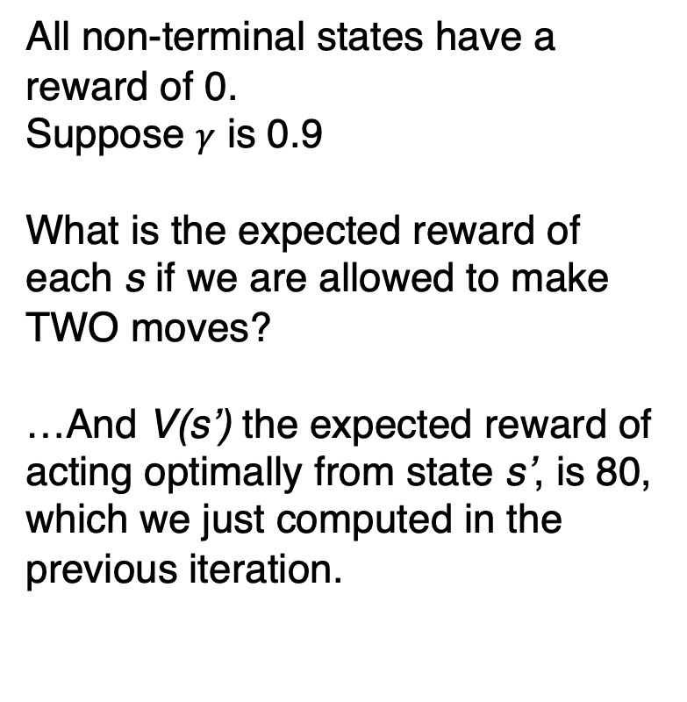
Stochastic Grid World Policy
0
?
80
+100
All non-terminal states have a reward of 0.
Suppose $γ$ is 0.9
What is the expected reward of each s if we are allowed to make TWO moves?
…And V(s’) the expected reward of acting optimally from state s’, is 80, which we just computed in the previous iteration.
$$s$$
$$s′$$
0
?
-100
0
0
0
0
$$?=0.80\left(0+0.9∗80\right)$$

Slide 105

Stochastic Grid World Policy
0
57
80
+100
All non-terminal states have a reward of 0.
Suppose $γ$ is 0.9
What is the expected reward of each s if we are allowed to make TWO moves?
…And this ends up being (about) 57.
$$s$$
$$s′$$
0
?
-100
0
0
0
0
$$57=0.80\left(0+0.9∗80\right)$$

Slide 106



Stochastic Grid World Policy
0
57
$$s′$$
+100
All non-terminal states have a reward of 0.
Suppose $γ$ is 0.9
What is the expected reward of each s if we are allowed to make TWO moves?
What about this guy? Transitioning to a state with estimated value of 80, so should be the same, right? 57 again?
80
0
$$s$$
-100
?
0
0
0
0
$$?=T\left(s,a,s^{′}\right)\left(R\left(s,a,s′\right)+γV\left(s′\right)\right)$$

Slide 107


Stochastic Grid World Policy
0
57
$$s′$$
+100
All non-terminal states have a reward of 0.
Suppose $γ$ is 0.9
What is the expected reward of each s if we are allowed to make TWO moves?
NO! we also have a chance to move East, into s’’. We need to consider *every* state an action might take us.
80
0
$$s$$
-100
?
$$s′′$$
0
0
0
0
$$?=\left[T\left(s,north,s^{′}\right)\left(R\left(s,a,s^{′}\right)+γV\left(s^{′}\right)\right)\right]+\left[T\left(s,north,s^{′}′\right)\left(R\left(s,a,s^{′′}\right)+γV\left(s^{′′}\right)\right)\right]$$

Slide 108

Stochastic Grid World Policy
0
57
$$s′$$
+100
All non-terminal states have a reward of 0.
Suppose $γ$ is 0.9
What is the expected reward of each s if we are allowed to make TWO moves?
80% chance of s’, 10% chance of s’’ when taking north action.
80
0
$$s$$
-100
?
$$s′′$$
0
0
0
0
$$?=\left[0.80\left(R\left(s,a,s^{′}\right)+γV\left(s^{′}\right)\right)\right]+\left[0.10\left(R\left(s,a,s^{′′}\right)+γV\left(s^{′′}\right)\right)\right]$$

Slide 109

Stochastic Grid World Policy
0
57
$$s′$$
+100
All non-terminal states have a reward of 0.
Suppose $γ$ is 0.9
What is the expected reward of each s if we are allowed to make TWO moves?
Reward of 0 for s’, reward of -100 for s’’
80
0
$$s$$
-100
?
$$s′′$$
0
0
0
0
$$?=\left[0.80\left(0+γV\left(s^{′}\right)\right)\right]+\left[0.10\left(−100+γV\left(s^{′′}\right)\right)\right]$$

Slide 110

Stochastic Grid World Policy
0
57
$$s′$$
+100
All non-terminal states have a reward of 0.
Suppose $γ$ is 0.9
What is the expected reward of each s if we are allowed to make TWO moves?
Discount factor is 0.90
80
0
$$s$$
-100
?
$$s′′$$
0
0
0
0
$$?=\left[0.80\left(0+0.90∗V\left(s^{′}\right)\right)\right]+\left[0.10\left(−100+0.90∗V\left(s^{′′}\right)\right)\right]$$

Slide 111

Stochastic Grid World Policy
0
57
$$s′$$
+100
All non-terminal states have a reward of 0.
Suppose $γ$ is 0.9
What is the expected reward of each s if we are allowed to make TWO moves?
Estimated reward for s’ is 80, estimated reward for s’’ is 0
80
0
$$s$$
-100
?
$$s′′$$
0
0
0
0
$$?=\left[0.80\left(0+0.90∗80\right)\right]+\left[0.10\left(−100+0.90∗0\right)\right]$$

Slide 112

Stochastic Grid World Policy
0
57
$$s′$$
+100
All non-terminal states have a reward of 0.
Suppose $γ$ is 0.9
What is the expected reward of each s if we are allowed to make TWO moves?
The ” s’ “ part of the equation IS 57, but the danger of walking into the fire subtracts 10 from it.
80
0
$$s$$
-100
?
$$s′′$$
0
0
0
0
$$?=57 −10$$

Slide 113

Stochastic Grid World Policy
0
57
$$s′$$
+100
All non-terminal states have a reward of 0.
Suppose $γ$ is 0.9
What is the expected reward of each s if we are allowed to make TWO moves?
Getting the actual estimated value of 47. Now we’re done, yeah?
80
0
$$s$$
-100
47
$$s′′$$
0
0
0
0
$$47=57 −10$$

Slide 114

Stochastic Grid World Policy
0
57
$$s′$$
+100
All non-terminal states have a reward of 0.
Suppose $γ$ is 0.9
What is the expected reward of each s if we are allowed to make TWO moves?
NOT YET! Often we need to update already computed reward estimates. This is known as the Bellman Update.
80
0
$$s$$
-100
47
$$s′′$$
0
0
0
0
$$47=57 −10$$

Slide 115



Stochastic Grid World Policy
0
57
$$s$$
+100
All non-terminal states have a reward of 0.
Suppose $γ$ is 0.9
What is the expected reward of each s if we are allowed to make TWO moves?
When we go east from s, there is a chance we ‘go north’ which keeps us in the same position, s’’.
80
$$s′$$
$$s′′$$
0
47
-100
0
0
0
0
$$?=\left[T\left(s,east,s^{′}\right)\left(R\left(s,east,s^{′}\right)+γV\left(s^{′}\right)\right)\right]+\left[T\left(s,east,s^{′}′\right)\left(R\left(s,east,s^{′′}\right)+γV\left(s^{′′}\right)\right)\right]$$

Slide 116

Stochastic Grid World Policy
0
57
$$s$$
+100
All non-terminal states have a reward of 0.
Suppose $γ$ is 0.9
What is the expected reward of each s if we are allowed to make TWO moves?
Probabilities are the same as we’ve seen before.
80
$$s′$$
$$s′′$$
0
47
-100
0
0
0
0
$$?=\left[0.80∗\left(R\left(s,east,s^{′}\right)+γV\left(s^{′}\right)\right)\right]+\left[0.10∗\left(R\left(s,east,s^{′′}\right)+γV\left(s^{′′}\right)\right)\right]$$

Slide 117

Stochastic Grid World Policy
0
57
$$s$$
+100
All non-terminal states have a reward of 0.
Suppose $γ$ is 0.9
What is the expected reward of each s if we are allowed to make TWO moves?
Rewards are the same, discount factors are the same.
80
$$s′$$
$$s′′$$
0
47
-100
0
0
0
0
$$?=\left[0.80∗\left(100+0.90∗V\left(s^{′}\right)\right)\right]+\left[0.10∗\left(0+0.90∗V\left(s^{′′}\right)\right)\right]$$

Slide 118

Stochastic Grid World Policy
0
57
$$s$$
+100
All non-terminal states have a reward of 0.
Suppose $γ$ is 0.9
What is the expected reward of each s if we are allowed to make TWO moves?
V(s’) is still 0. But V(s’’), computed from the previous iteration, is now 80
80
$$s′$$
$$s′′$$
0
47
-100
0
0
0
0
$$?=\left[0.80∗\left(100+0.90∗0.0\right)\right]+\left[0.10∗\left(0+0.90∗80\right)\right]$$

Slide 119


Stochastic Grid World Policy
0
57
$$s$$
+100
All non-terminal states have a reward of 0.
Suppose $γ$ is 0.9
What is the expected reward of each s if we are allowed to make TWO moves?
You might ask yourself, well, we ALSO might have moved south when going east. Why not also s’’’
80
$$s′$$
$$s′′$$
0
47
-100
$$s′′′$$
0
0
0
0
$?=\left[0.80∗\left(100+0.90∗0.0\right)\right]+\left[0.10∗\left(0+0.90∗80\right)\right]$ + s’’’ ????

Slide 120

Stochastic Grid World Policy
0
57
$$s$$
+100
All non-terminal states have a reward of 0.
Suppose $γ$ is 0.9
What is the expected reward of each s if we are allowed to make TWO moves?
And the answer is: technically yes, BUT at end of *previous* iteration, both reward and expected reward for s’’’ was 0.
80
$$s′$$
$$s′′$$
0
47
-100
$$s′′′$$
0
0
0
0
$?=\left[0.80∗\left(100+0.90∗0.0\right)\right]+\left[0.10∗\left(0+0.90∗80\right)\right]$ + $\left[0.10∗\left(0+0.90∗0\right)\right]$

Slide 121

Stochastic Grid World Policy
0
57
$$s$$
+100
All non-terminal states have a reward of 0.
Suppose $γ$ is 0.9
What is the expected reward of each s if we are allowed to make TWO moves?
Which means that term just ends up being 0, so we left it out.
80
$$s′$$
$$s′′$$
0
47
-100
$$s′′′$$
0
0
0
0
$?=\left[0.80∗\left(100+0.90∗0.0\right)\right]+\left[0.10∗\left(0+0.90∗80\right)\right]$ + $0$

Slide 122

Stochastic Grid World Policy
0
57
$$s$$
+100
All non-terminal states have a reward of 0.
Suppose $γ$ is 0.9
What is the expected reward of each s if we are allowed to make TWO moves?
Anyway, we do this other arithmetic…
80
$$s′$$
$$s′′$$
0
47
-100
$$s′′′$$
0
0
0
0
$?=80+7.2$ + $0$

Slide 123

Stochastic Grid World Policy
0
57
$$s$$
+100
All non-terminal states have a reward of 0.
Suppose $γ$ is 0.9
What is the expected reward of each s if we are allowed to make TWO moves?
And we get our updated value!
87
$$s′$$
$$s′′$$
0
47
-100
$$s′′′$$
0
0
0
0
$87=80+7.2$ + $0$

Slide 124

Stochastic Grid World Policy
0
57
87
+100
All non-terminal states have a reward of 0.
Suppose $γ$ is 0.9
What is the expected reward of each s if we are allowed to make TWO moves?
And this can keep going!
0
47
-100
0
0
0
0

Slide 125

Stochastic Grid World Policy
41
73
92
+100
All non-terminal states have a reward of 0.
Suppose $γ$ is 0.9
What is the expected reward of each s if we are allowed to make THREE moves?
Bumping up the available moves to three makes a bunch more updates.
0
57
-100
0
0
34
0

Slide 126

Stochastic Grid World Policy
56
79
93
+100
All non-terminal states have a reward of 0.
Suppose $γ$ is 0.9
What is the expected reward of each s if we are allowed to make FOUR moves?
And so on..
29
61
-100
0
24
41
14

Slide 127

Stochastic Grid World Policy
65
81
93
+100
All non-terminal states have a reward of 0.
Suppose $γ$ is 0.9
What is the expected reward of each s if we are allowed to make FIVE moves?
Note that those first states we computed are changing less dramatically at this point.
45
62
-100
23
34
47
20

Slide 128

Stochastic Grid World Policy
68
82
94
+100
All non-terminal states have a reward of 0.
Suppose $γ$ is 0.9
What is the expected reward of each s if we are allowed to make SIX moves?
Note that those first states we computed are changing less dramatically at this point.
55
63
-100
38
40
50
26

Slide 129

Stochastic Grid World Policy
?
?
?
+100
All non-terminal states have a reward of 0.
Suppose $γ$ is 0.9
What is the expected reward of each s if we are allowed to make ∞ moves?
Eventually, the expected rewards converge to an equilibrium. And then you can definitely determine your policy!
?
?
-100
?
?
?
?

Slide 130
Value Iteration
This process of iteratively refining the utility / estimated rewards of each state is called value iteration.
We can do it as long we know the Markov process (e.g., what the probability of any given action leading us to any given other state is, the rewards, actions, states, etc.).
As you saw, it gets its name through that iterative process (first 1 move, then 2 moves, then three moves, etc.)

Slide 131
Value Iteration
We mentioned that sometimes these tasks never end
E.g., learning how to play the piano.
But even in situations like that, we’ll still converge to an equilibrium, because as long as the discount factor is < 1, if you look far enough into the future the reward of those far future actions eventually approach 0.
But this is very inefficient!

Slide 132

Markov Decision Process
Our Markov decision process is defined as:
A set of states $s∈S$
A set of actions $a∈A$
A start state $s_{0}$
Optionally a set of terminal states $\left\{g_{1},g_{2}…\right\}∈S$
A reward function $R\left(s,a,s′\right)$
A transition function T(s, a, s’)

Slide 133
Markov Decision Process
Our Markov decision process is defined as:
A set of states $s∈S$
A set of actions $a∈A$
A start state $s_{0}$
Optionally a set of terminal states $\left\{g_{1},g_{2}…\right\}∈S$
A reward function $R\left(s,a,s′\right)$
A transition function T(s, a, s’)
Value iteration requires us to know all of these things in advance.

Slide 134

Markov Decision Process
Our Markov decision process is defined as:
A set of states $s∈S$
A set of actions $a∈A$
A start state $s_{0}$
Optionally a set of terminal states $\left\{g_{1},g_{2}…\right\}∈S$
A reward function $R\left(s,a,s′\right)$
A transition function T(s, a, s’)
What if…
These red highlights were fixed (i.e., they aren’t going to change), but we don’t know what they are in advance?
Can we still figure out a policy?

Slide 135
Reinforcement Learning
Let’s assume the world works like a stochastic process that obeys the Markov property.
i.e., previous states and actions don’t matter to your current decision – all that matters to the next state is your current state and what action you choose *now.*
We will explore the world, learning about new states and their rewards as we go.
Over time, we will learn which states lead to high rewards and which lead to low.
This is done through connected (but slightly different!) processes known as exploring and exploiting.

Slide 136
Exploring a Markov Decision Process (MDP)
To explore an unknown MDP that starts in state s0:
Until you run out of time to explore:
Let s be s0.
Until s is a terminal state:
Choose action a at random.
Let s' be the state after taking a in s.
Let s be s'.

Slide 137
Exploiting a Markov Decision Process (MDP)
To exploit an unknown MDP that starts in state s0:
Until you run out of time to explore:
Let s be s0.
Until s is a terminal state:
Choose action a that has highest expected reward.
Let s' be the state after taking a in s.
Let s be s'.

Slide 138
Exploiting a Markov Decision Process (MDP)
To exploit an unknown MDP that starts in state s0:
Until you run out of time to explore:
Let s be s0.
Until s is a terminal state:
Choose action a that has highest expected reward.
Let s' be the state after taking a in s.
Let s be s'.

Slide 139
Explore and Exploit an MDP
To learn an unknown MDP that starts in state s0:
Let 0 ≤ n ≤ 1 be the "noise" parameter.
Until you run out of time to explore:
Let s be s0.
Until s is a terminal state:
With probability < n:
Choose action a at random.
Else:
Choose action a that has highest expected reward.
Let s' be the state after taking a in s.
Let s be s'.

Slide 140
Explore and Exploit an MDP
To learn an unknown MDP that starts in state s0:
Let 0 ≤ n ≤ 1 be the "noise" parameter.
Until you run out of time to explore:
Let s be s0.
Until s is a terminal state:
With probability < n:
Choose action a at random.
Else:
Choose action a that has highest expected reward.
Let s' be the state after taking a in s.
Let s be s'.
We will be filling in some missing parts here shortly!
Namely, we will be building a Q Table

Slide 141

Q Table
State | north | south | east | west
$$x=1, y=1$$ | $$0.95$$ | $$0.55$$ | $$0.05$$ | $$−0.35$$
$$x=2, y=1$$ | $$0.62$$ | $$−0.25$$ | $$0. 50$$ | $$−0.20$$
… | … | … | … | …
$$x=5,y=5$$ | $$0.23$$ | $$−0.04$$ | $$0.52$$ | $$0.18$$

Slide 142

Q Table
State | north | south | east | west
$$x=1, y=1$$ | $$0.95$$ | $$0.55$$ | $$0.05$$ | $$−0.35$$
$$x=2, y=1$$ | $$0.62$$ | $$−0.25$$ | $$0. 50$$ | $$−0.20$$
… | … | … | … | …
$$x=5,y=5$$ | $$0.23$$ | $$−0.04$$ | $$0.52$$ | $$0.18$$
One row for each state we might be in.

Slide 143
Q Table
State | north | south | east | west
$$x=1, y=1$$ | $$0.95$$ | $$0.55$$ | $$0.05$$ | $$−0.35$$
$$x=2, y=1$$ | $$0.62$$ | $$−0.25$$ | $$0. 50$$ | $$−0.20$$
… | … | … | … | …
$$x=5,y=5$$ | $$0.23$$ | $$−0.04$$ | $$0.52$$ | $$0.18$$
One column for each action we can take

Slide 144

Q Table
State | north | south | east | west
$$x=1, y=1$$ | $$0.95$$ | $$0.55$$ | $$0.05$$ | $$−0.35$$
$$x=2, y=1$$ | $$0.62$$ | $$−0.25$$ | $$0. 50$$ | $$−0.20$$
… | … | … | … | …
$$x=5,y=5$$ | $$0.23$$ | $$−0.04$$ | $$0.52$$ | $$0.18$$
An individual cell represents the expected reward for taking that action in that state.

Slide 145

Q Table
State | north | south | east | west
$$x=1, y=1$$ | $$0.95$$ | $$0.55$$ | $$0.05$$ | $$−0.35$$
$$x=2, y=1$$ | $$0.62$$ | $$−0.25$$ | $$0. 50$$ | $$−0.20$$
… | … | … | … | …
$$x=5,y=5$$ | $$0.23$$ | $$−0.04$$ | $$0.52$$ | $$0.18$$
The name Q Table comes from this equation we’ve been working with:
$$Q\left(s,a\right)=\sum_{s′}{T\left(s,a,s′\right)⋅\left(R\left(s,a,s^{′}\right)+γV\left(s′\right)\right)}$$

Slide 146

Q Table
State | north | south | east | west
$$x=1, y=1$$ | $$0.95$$ | $$0.55$$ | $$0.05$$ | $$−0.35$$
$$x=2, y=1$$ | $$0.62$$ | $$−0.25$$ | $$0. 50$$ | $$−0.20$$
… | … | … | … | …
$$x=5,y=5$$ | $$0.23$$ | $$−0.04$$ | $$0.52$$ | $$0.18$$
We can use this table to calculate:
$$V\left(s\right)=\max_{a}{Q\left(s,a\right)}$$

Slide 147

Q Table
State | north | south | east | west
$$x=1, y=1$$ | $$0.95$$ | $$0.55$$ | $$0.05$$ | $$−0.35$$
$$x=2, y=1$$ | $$0.62$$ | $$−0.25$$ | $$0. 50$$ | $$−0.20$$
… | … | … | … | …
$$x=5,y=5$$ | $$0.23$$ | $$−0.04$$ | $$0.52$$ | $$0.18$$
What’s the best outcome for this state?
We can use this table to calculate:
$$V\left(s\right)=\max_{a}{Q\left(s,a\right)}$$

Slide 148
Q Table
State | north | south | east | west
$$x=1, y=1$$ | $$0.95$$ | $$0.55$$ | $$0.05$$ | $$−0.35$$
$$x=2, y=1$$ | $$0.62$$ | $$−0.25$$ | $$0. 50$$ | $$−0.20$$
… | … | … | … | …
$$x=5,y=5$$ | $$0.23$$ | $$−0.04$$ | $$0.52$$ | $$0.18$$
This is the expected reward
We can use this table to calculate:
$V\left(x=1,y=1\right)=\max_{a}{Q\left(x=1y=1,a\right)}$ = 0.95

Slide 149

Q Table
State | north | south | east | west
$$x=1, y=1$$ | $$0.95$$ | $$0.55$$ | $$0.05$$ | $$−0.35$$
$$x=2, y=1$$ | $$0.62$$ | $$−0.25$$ | $$0. 50$$ | $$−0.20$$
… | … | … | … | …
$$x=5,y=5$$ | $$0.23$$ | $$−0.04$$ | $$0.52$$ | $$0.18$$
This is the action you should take
We can use this table to calculate:
$V\left(x=1,y=1\right)=Q\left(x=1y=1,north\right)$= 0.95

Slide 150
Q Learning – setup.
Let 0 ≤ n ≤ 1 be the "noise" parameter.
Let 0 ≤ α ≤ 1 be the "learning rate" parameter.
Let 0 ≤ γ ≤ 1 be the "reward discount" parameter.
Let Q(s,a) be a table with a row for each state s and a column for each action a.
Let V(s) be a function which returns the highest value of Q(s,a) for all a.
Initially, for all s and for all a, Q(s,a) = 0.
...

Slide 151
Q Learning
...
Until you run out of time to explore:
Let s be s0.
Until s is a terminal state:
With probability < n:
Choose action a at random.
Else:
Choose action a that maximizes Q(s,a).
Let s' be the state after taking a in s.
Let r be the reward for taking a in s.
Let Q(s,a) = (1 - α) Q(s,a) + α(r + γV(s'))
Let s be s'.

Slide 152
Q Learning
...
Until you run out of time to explore:
Let s be s0.
Until s is a terminal state:
With probability < n:
Choose action a at random.
Else:
Choose action a that maximizes Q(s,a).
Let s' be the state after taking a in s.
Let r be the reward for taking a in s.
Let Q(s,a) = (1 - α) Q(s,a) + α(r + γV(s'))
Let s be s'.
It’s the same as explore and exploit from before! With this extra bit!
We are just updating our table, based on lots of parameters…

Slide 153
Q Learning Parameters
With probability < n move randomly
N is the noise
Low values mean the agent rarely makes random moves (prefers to exploit, i.e., do things it currently believes is best).
High values mean the agent often makes random moves (prefers to explore, i.e., potentially discover new things that are best! Or… maybe be really bad).

Slide 154

Q Learning Parameters
Q(s,a) = (1 - α) Q(s,a) + α(r + γV(s'))
$α$ is the learning rate, and affects how much we update the table.

Slide 155

Q Learning Parameters
We update the table to be…
Q(s,a) = (1 - α) Q(s,a) + α(r + γV(s'))
$α$ is the learning rate, and affects how much we update the table.

Slide 156

Q Learning Parameters
Its current values, weighted by a factor of 1 – α…
Q(s,a) = (1 - α) Q(s,a) + α(r + γV(s'))
$α$ is the learning rate, and affects how much we update the table.

Slide 157

Q Learning Parameters
Nudged a bit by the current reward and future expected reward, weighted by a factor of α
Q(s,a) = (1 - α) Q(s,a) + α(r + γV(s'))
$α$ is the learning rate, and affects how much we update the table.

Slide 158

Q Learning Parameters
Q(s,a) = (1 - α) Q(s,a) + α(r + γV(s'))
$α$ is the learning rate.
Low values of $α$ mean (1 - α) will be close to 1, and the existing table updates slowly (the agent is set in its ways).
High values mean that (1 - α) will be close to 0, and the existing table updates quickly (the agent is forgetful).

Slide 159

Q Learning Parameters
Q(s,a) = (1 - α) Q(s,a) + α(r + γV(s'))
γ is still the discount factor.
Low values of γ mean the agent cares more about short-term rewards (shortsighted agent).
High values mean that the agent highly values long-term rewards (far sighted agent).

Slide 160
Q Learning Policies
Typically, reinforcement learning agents alternate between two phases: learning and evaluation.
Learning is when you develop your policy.
During learning, explore, exploit, and update the Q table as you go.
Evaluation is when you test your policy
During evaluation, you always exploit (i.e., do the action that you think will get you the highest score).

Slide 161
Q Learning Policies
A policy is a function that takes a state as input and returns the action the agent should do in that state.
During learning, a Q Learning agent fills in its Q Table.
Policy: In state s, check row s in the Q Table and choose the action with the highest value.
In other words, in state s, always choose the action a that maximizes Q(s,a).

